Slide 1
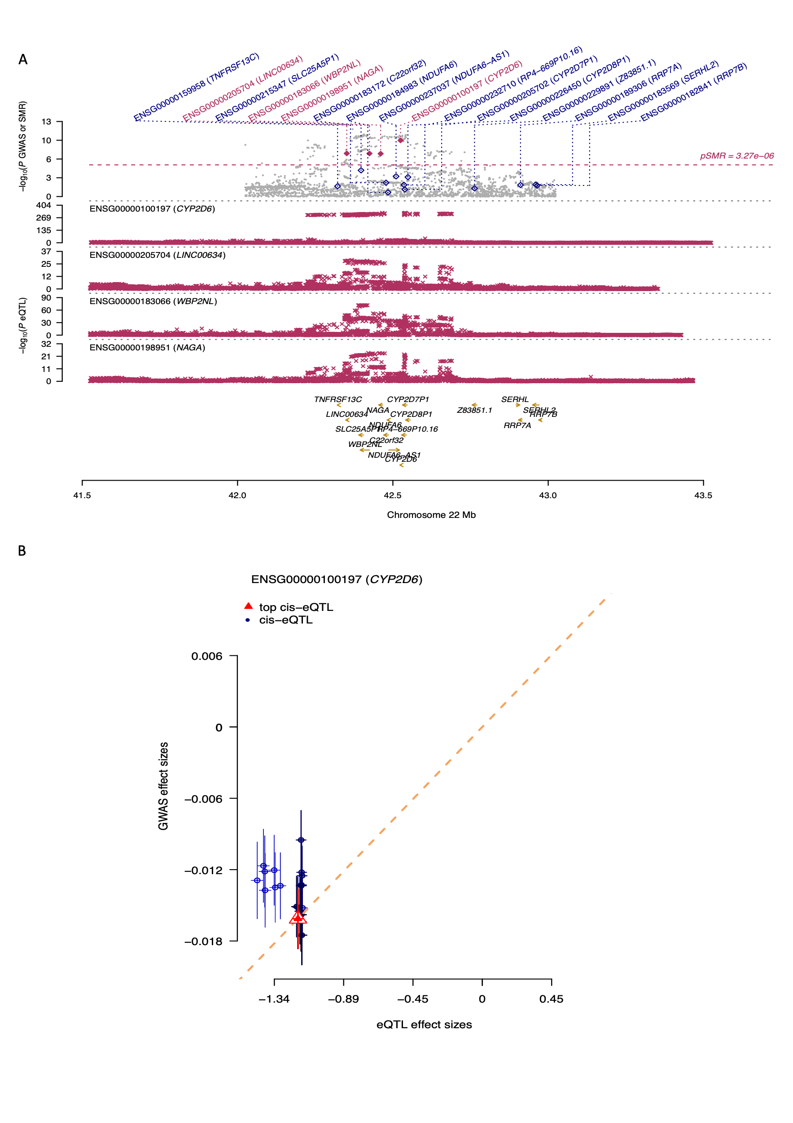
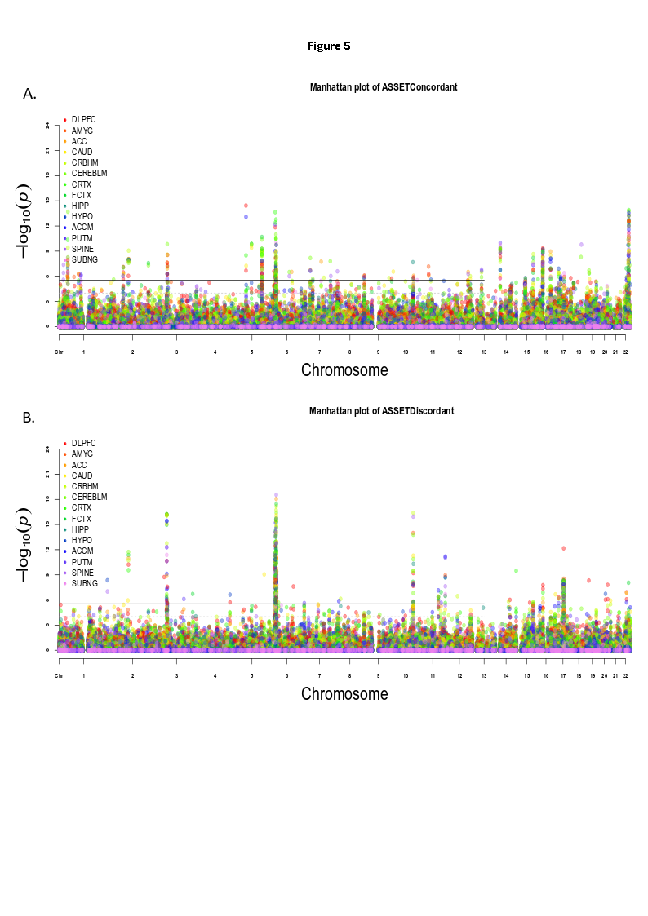
Transcriptome Wide Analysis – An Introduction
Max Lam, Ph.D

Slide 2
Concept of TWAS
Why TWAS?

Slide 3
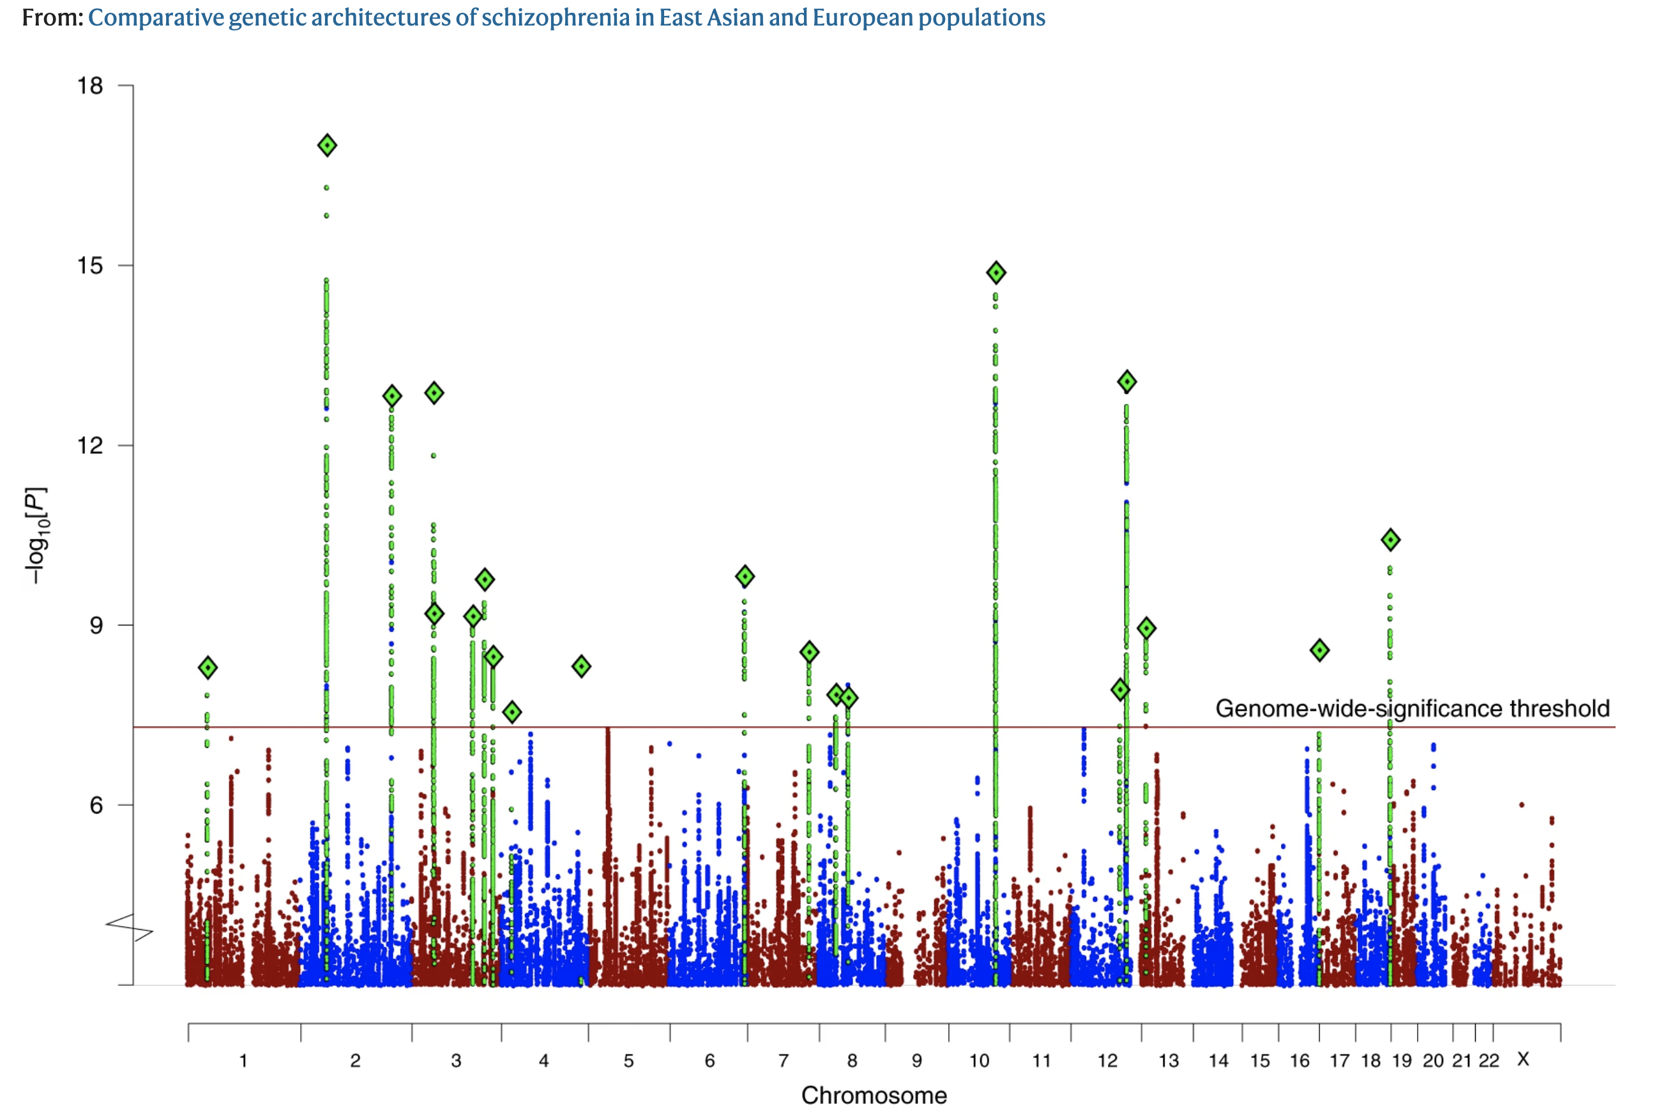
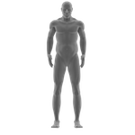
In the beginning there was GWAS….
Cases v Controls
Often times effect sizes are small
Large sample sizes are required
From: Comparative genetic architectures of schizophrenia in East Asian and European populations
Nature Genetics
X 10 million
rs1234
rs2345
rs3456
rs4567
rs5678
Graphics from https://www.flaticon.com/

Slide 4
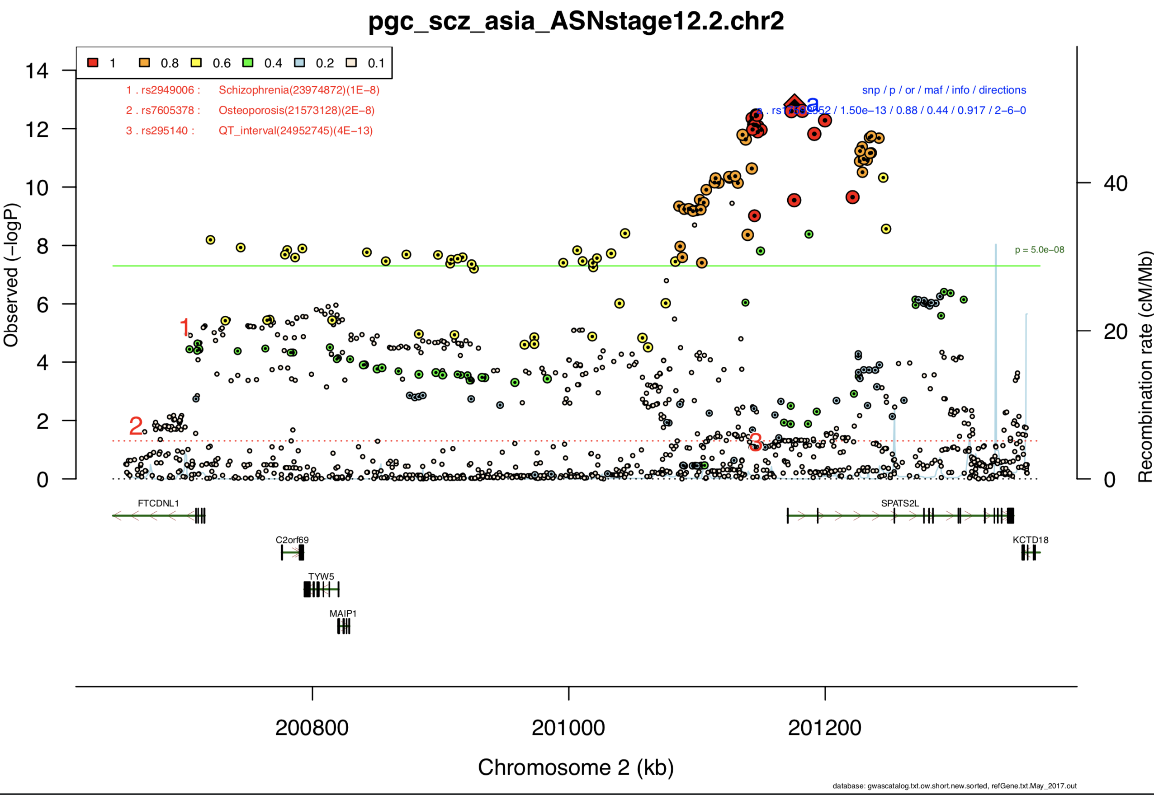
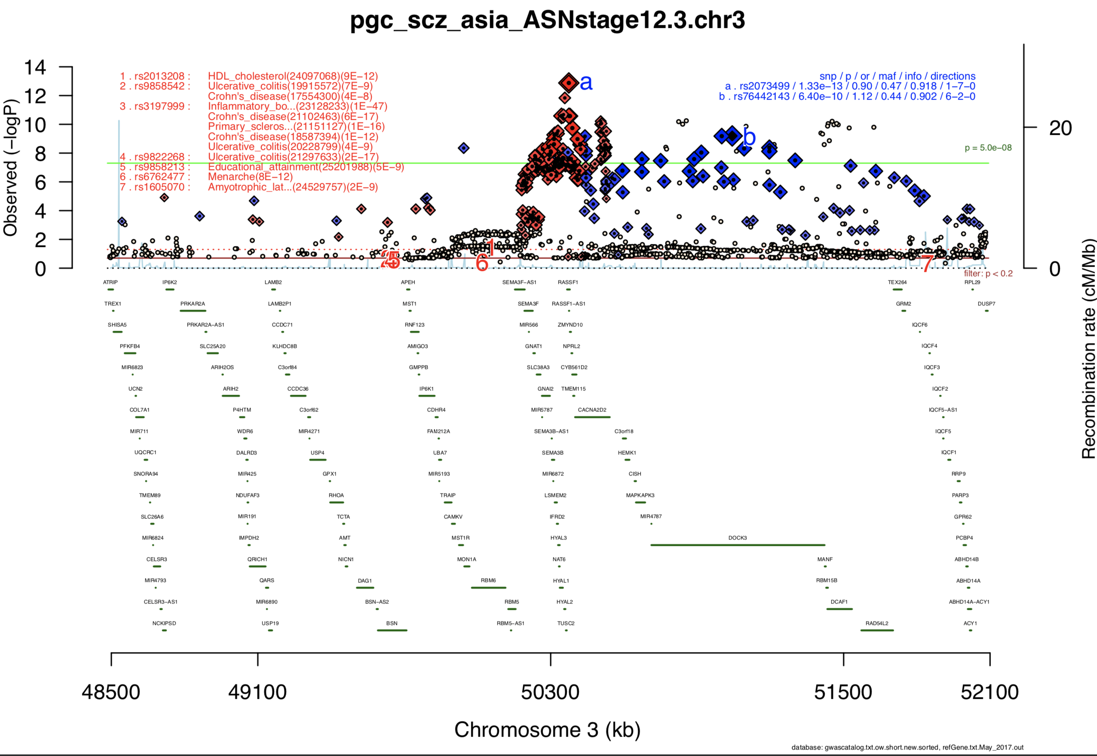
Great! We’ve got a significant GWAS finding….but…
The SNPs are all highly correlated! GWAS tells us that a region in the genome is associated with a trait…but it doesn’t really tell us which gene is driving the signal…
Any idea which gene is responsible for the GWAS signal?
From: Comparative genetic architectures of schizophrenia in East Asian and European populations
Nature Genetics

Slide 5
Isolating gene function is crucial….
But in reality (especially) in polygenic traits…
Graphic from WikiCommons
Gene structure/function in brief
Frequency
Trait

Slide 6
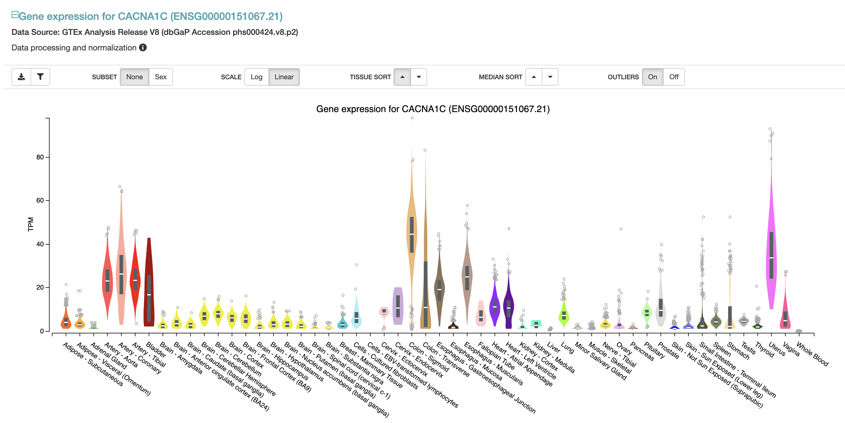
Cataloguing gene function – gene expression
Calcium Channel Gene – CACNA1C

Slide 7
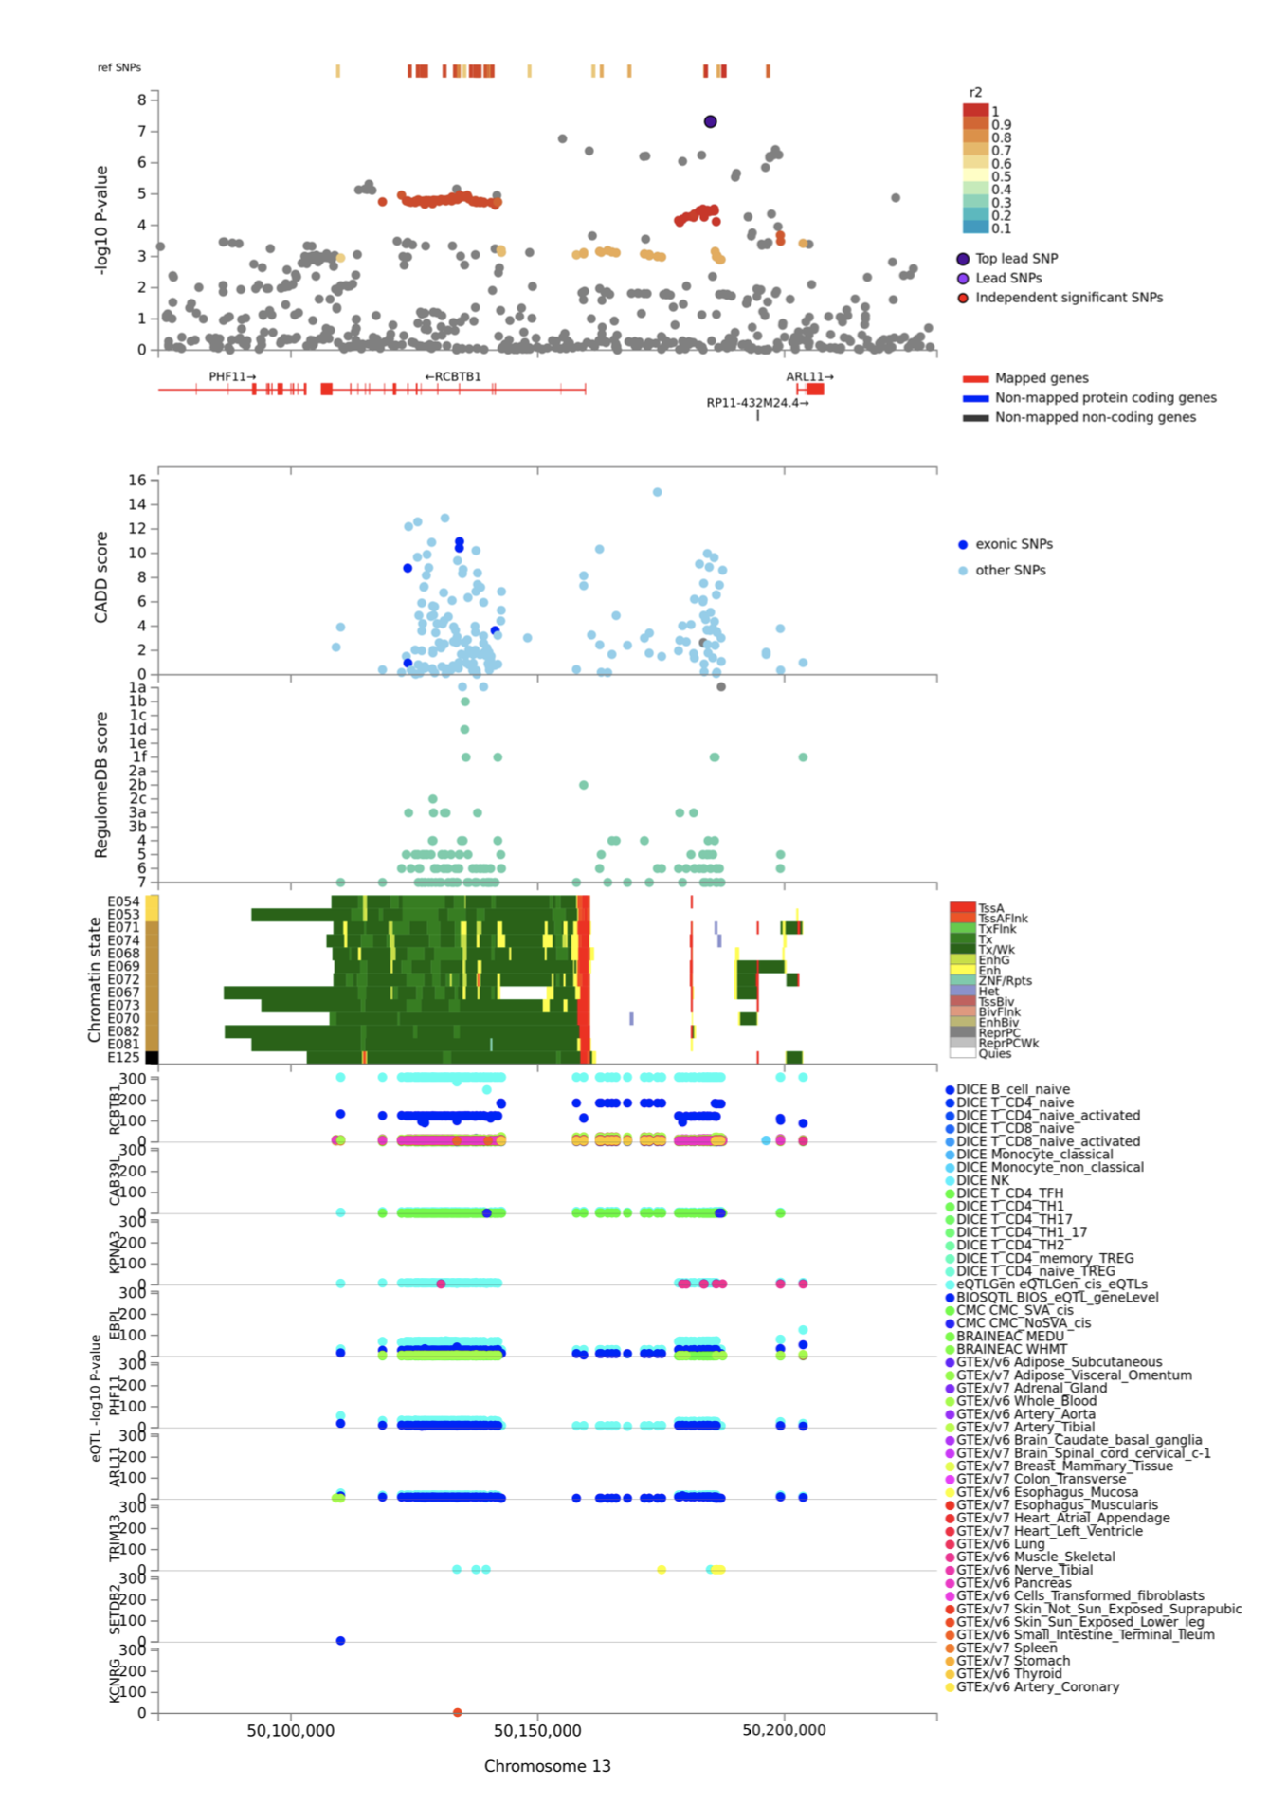
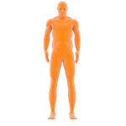
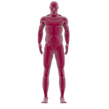
eQTL mapping
EAS, EUR, AMR?
https://fuma.ctglab.nl/
GWAS Signal
Principle : The variant (SNP) associated with a trait happens to be sitting within the boundaries of a gene. The gene happens to be expressed.
Potential Limitations:
eQTL database are usually derived from one population, GWAS from another
Which are the SNP(s) that are driving the expression?
Concepts
Population structure, LD patterns underlying eQTL signals, genetic architecture of a investigated trait.
Common eQTL databases
GTEx v8
Common Mind Consortium
PsychENCODE
Blood eQTL
eQTL Mapping
Mostly EUR

Slide 8
Transcriptomic Wide Analysis
Represents some advancement over simply “eye-balling” similar location
Key Assumption:
The genetic architecture of gene expression overlaps with the genetic architecture of the trait being investigated
Value add:
Statistical properties to GWAS association, versus gene expression vs trait.
Why important:
GWAS : Trait = b1*genotype + residual
TWAS : Trait = b1*genotype + b2*eQTL + residual
Colocalization
Predixcan/S-Predixcan
SMR/HEIDI
FOCUS

Slide 9
TWAS use case
Largest TWAS effort at present….

Slide 10
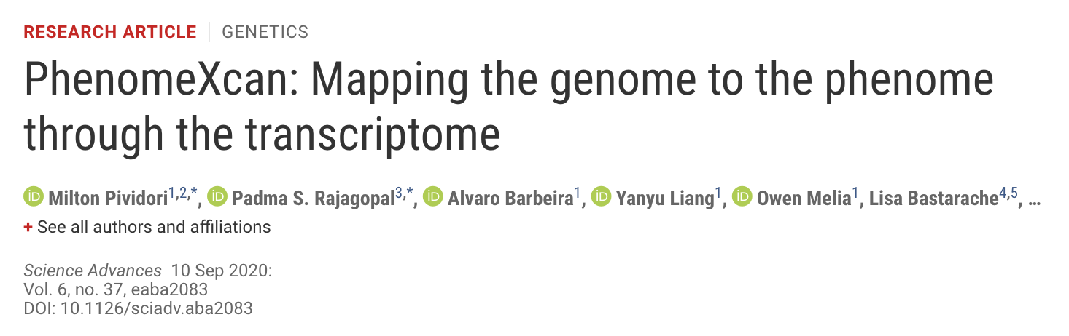
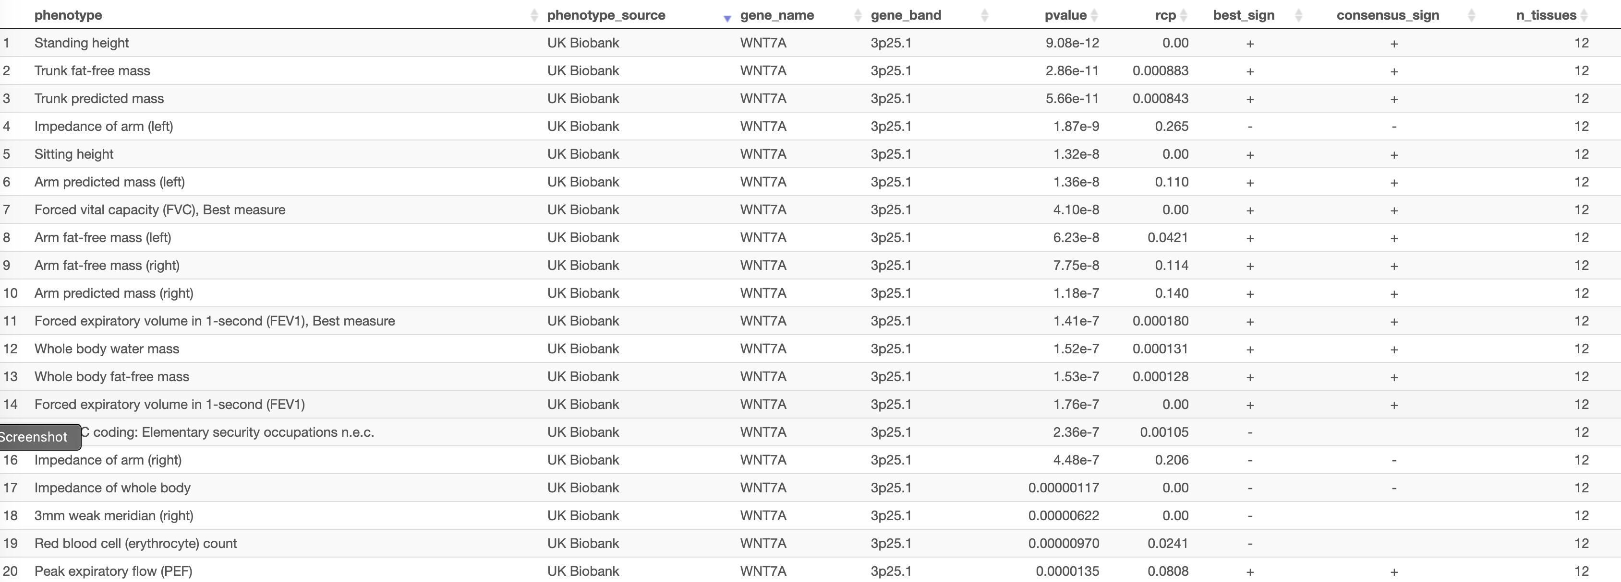
PhenomeXcan, synthesizes 8.87 million variants from genome-wide association study summary statistics on 4091 traits with transcriptomic data from 49 tissues in Genotype-Tissue Expression v8 into a gene-based, queryable platform including 22,515 genes
http://apps.hakyimlab.org/phenomexcan/

Slide 11

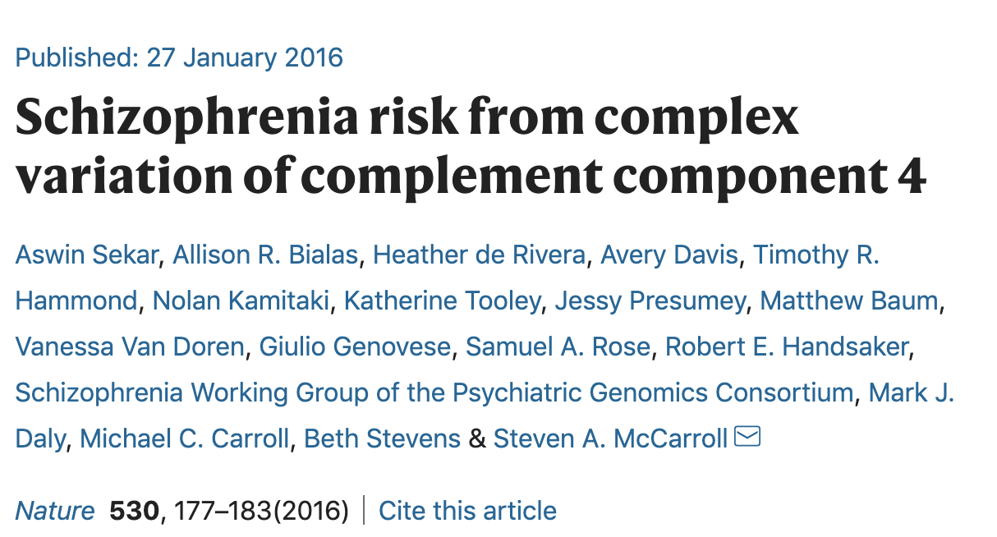
Why PhenomeXcan?
Integration of genomic, transcriptomic, and other regulatory and functional information offers crucial justification for therapeutic target identification efforts, such as drug development. Translational researchers also need access to this integrated information in a comprehensive platform that allows convenient investigation of complex relationships across multiple genes and traits. – Pividori et al., 2020

Slide 12
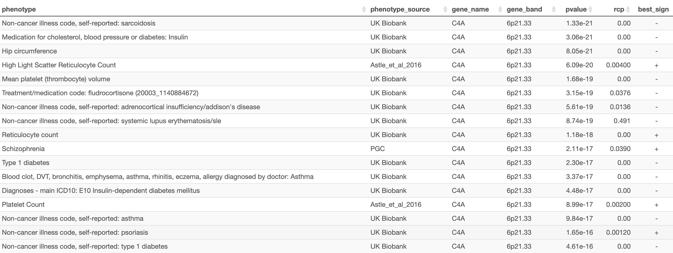
C4A and Schizophrenia…But maybe diabetes too?

Slide 13
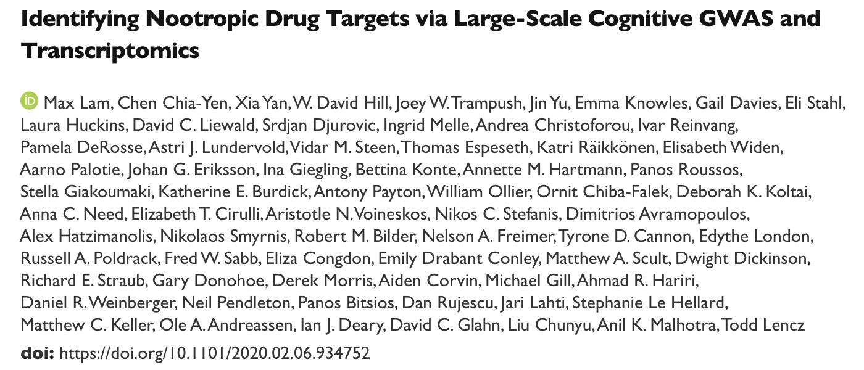
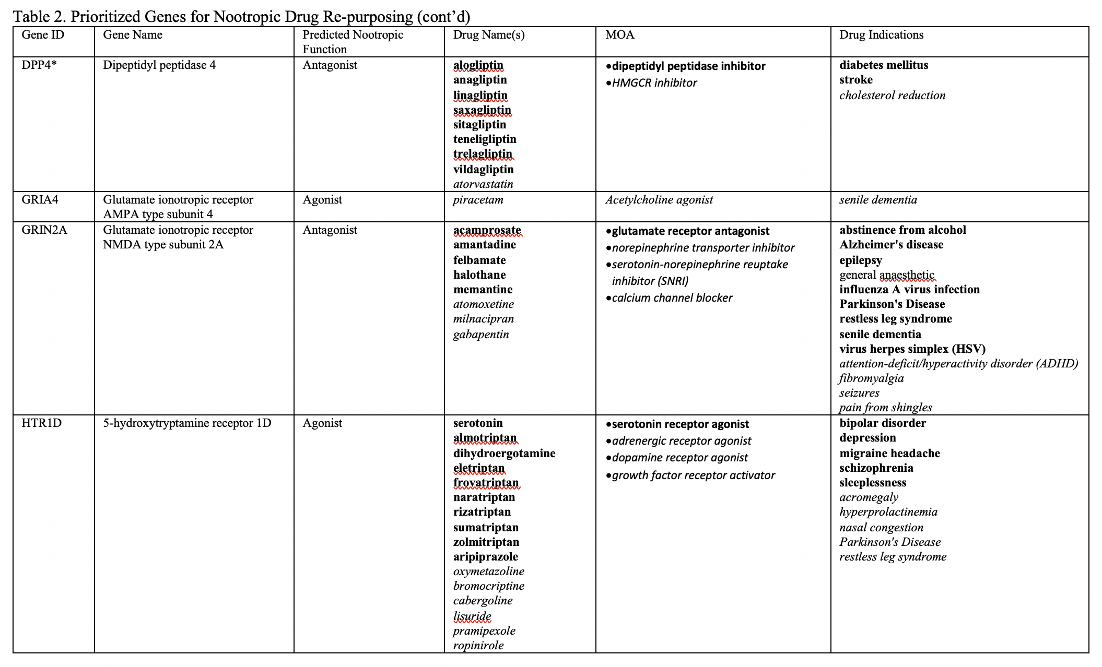
Using TWAS to identify genes that might be potential drug targets for Nootropics

Slide 14
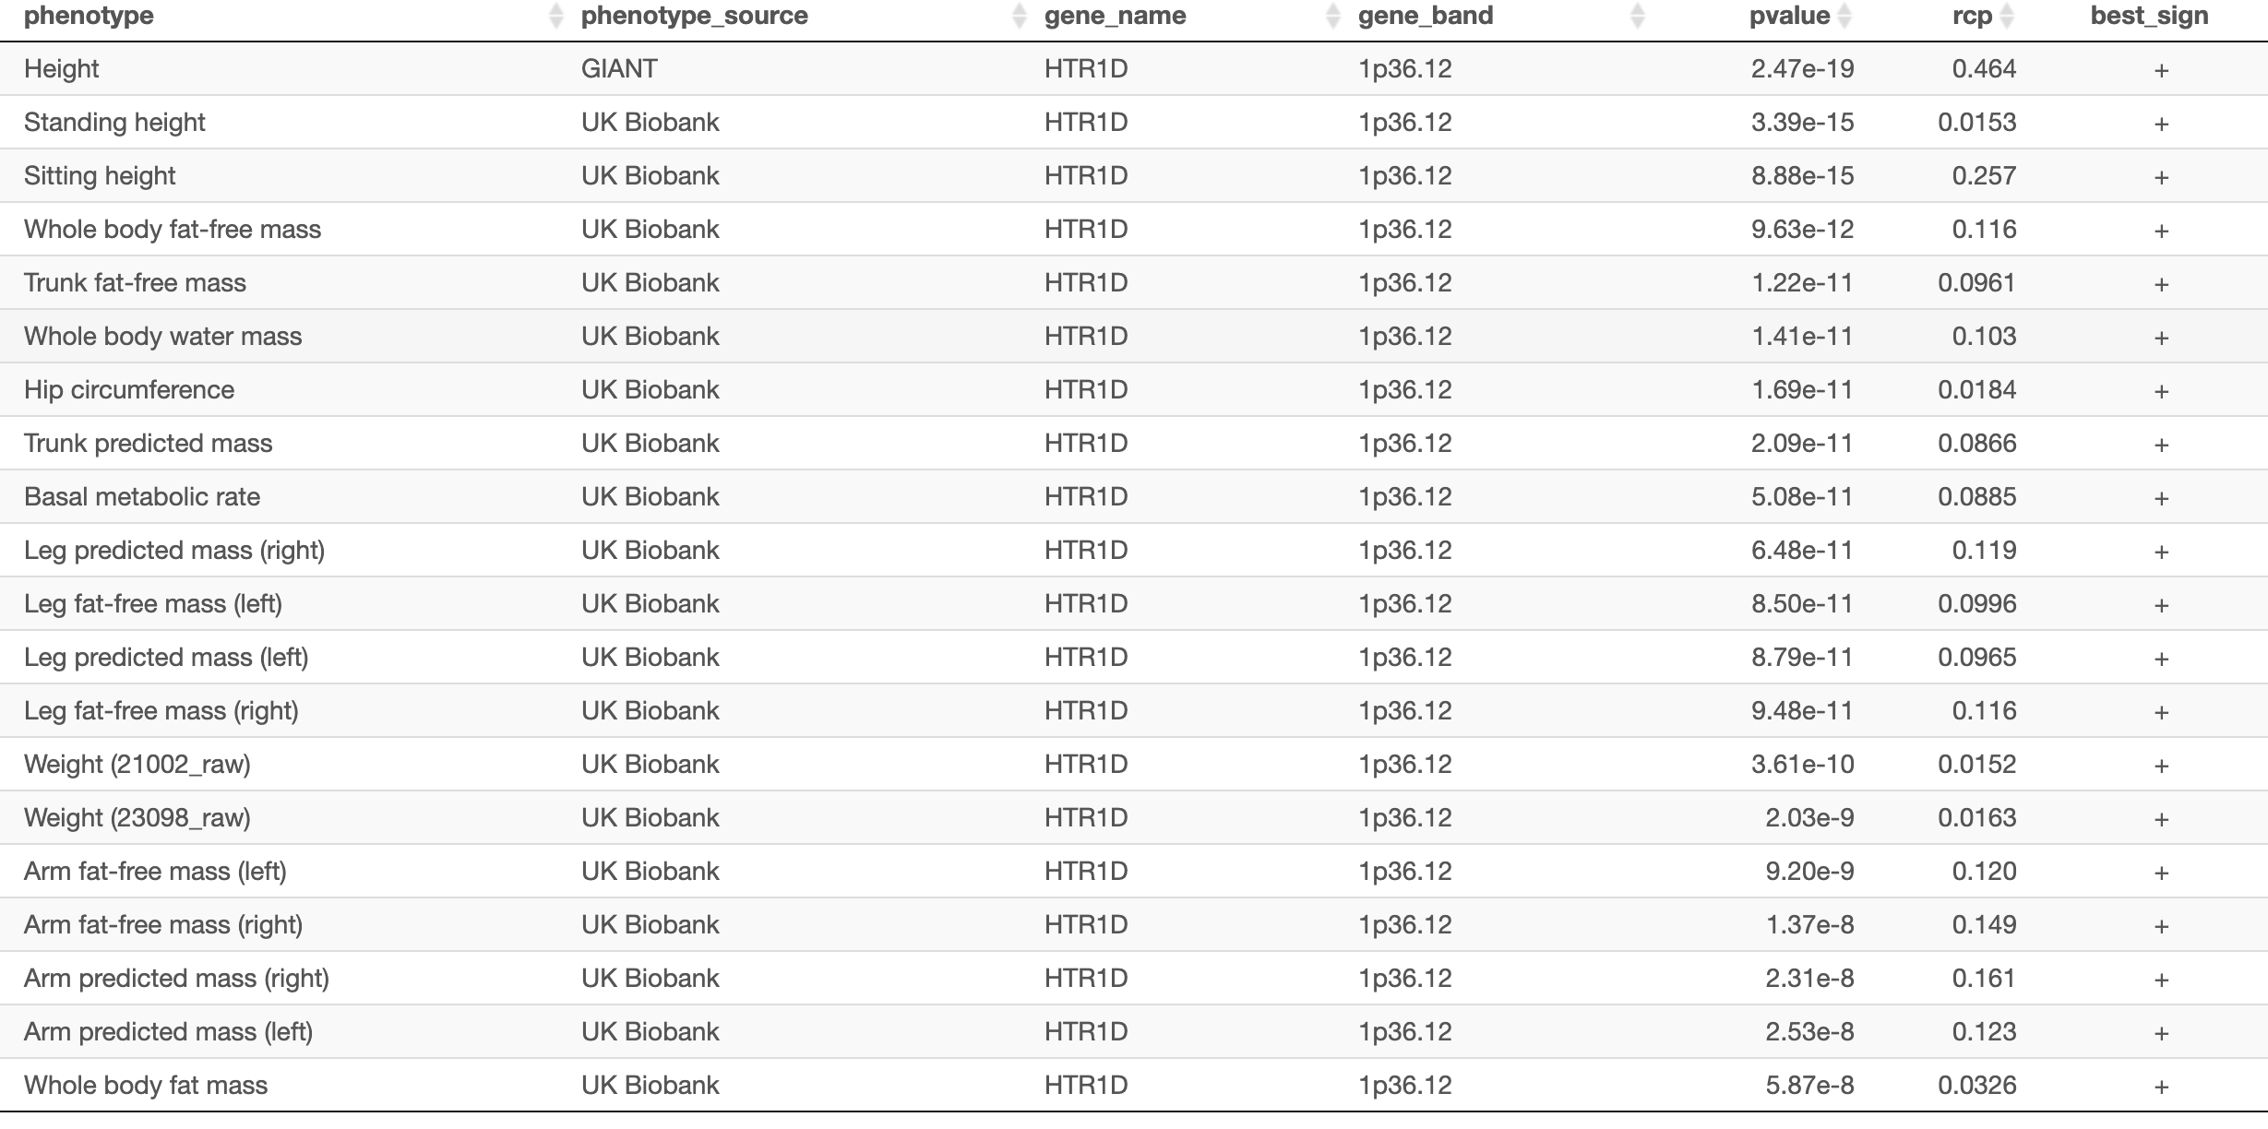

Hmm…But what if…

Slide 15
TWAS gives us a clue to whether gene function (aka expression) can be remotely connected to the phenotype – and ultimately what phenotypes the gene affects…
1. Variant associations genome-wide tells us that a particular segment of the genome is related to a given trait
2. There could be many genes expressed in that segment of the genome
3. We could somehow connect the variant to the gene, and figure out that the expression of the gene could likely affect the phenotype using TWAS as a tool
4. Wait…How was the expression (aka function) of the gene measured?

Slide 16
Measuring the gene expression : GTEx & PsychENCODE
It’s a major component for TWAS….

Slide 17
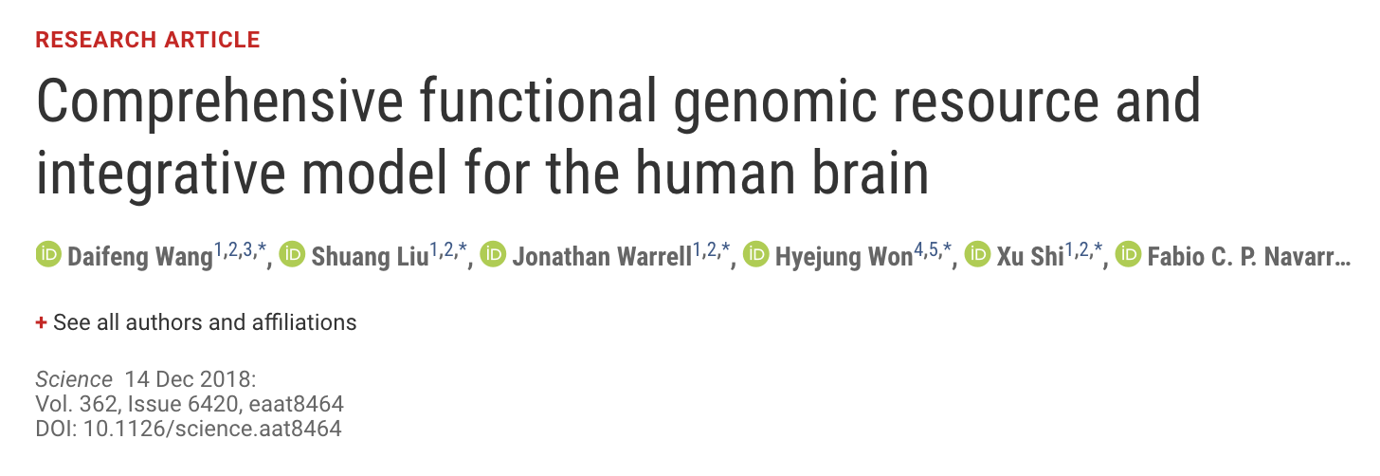
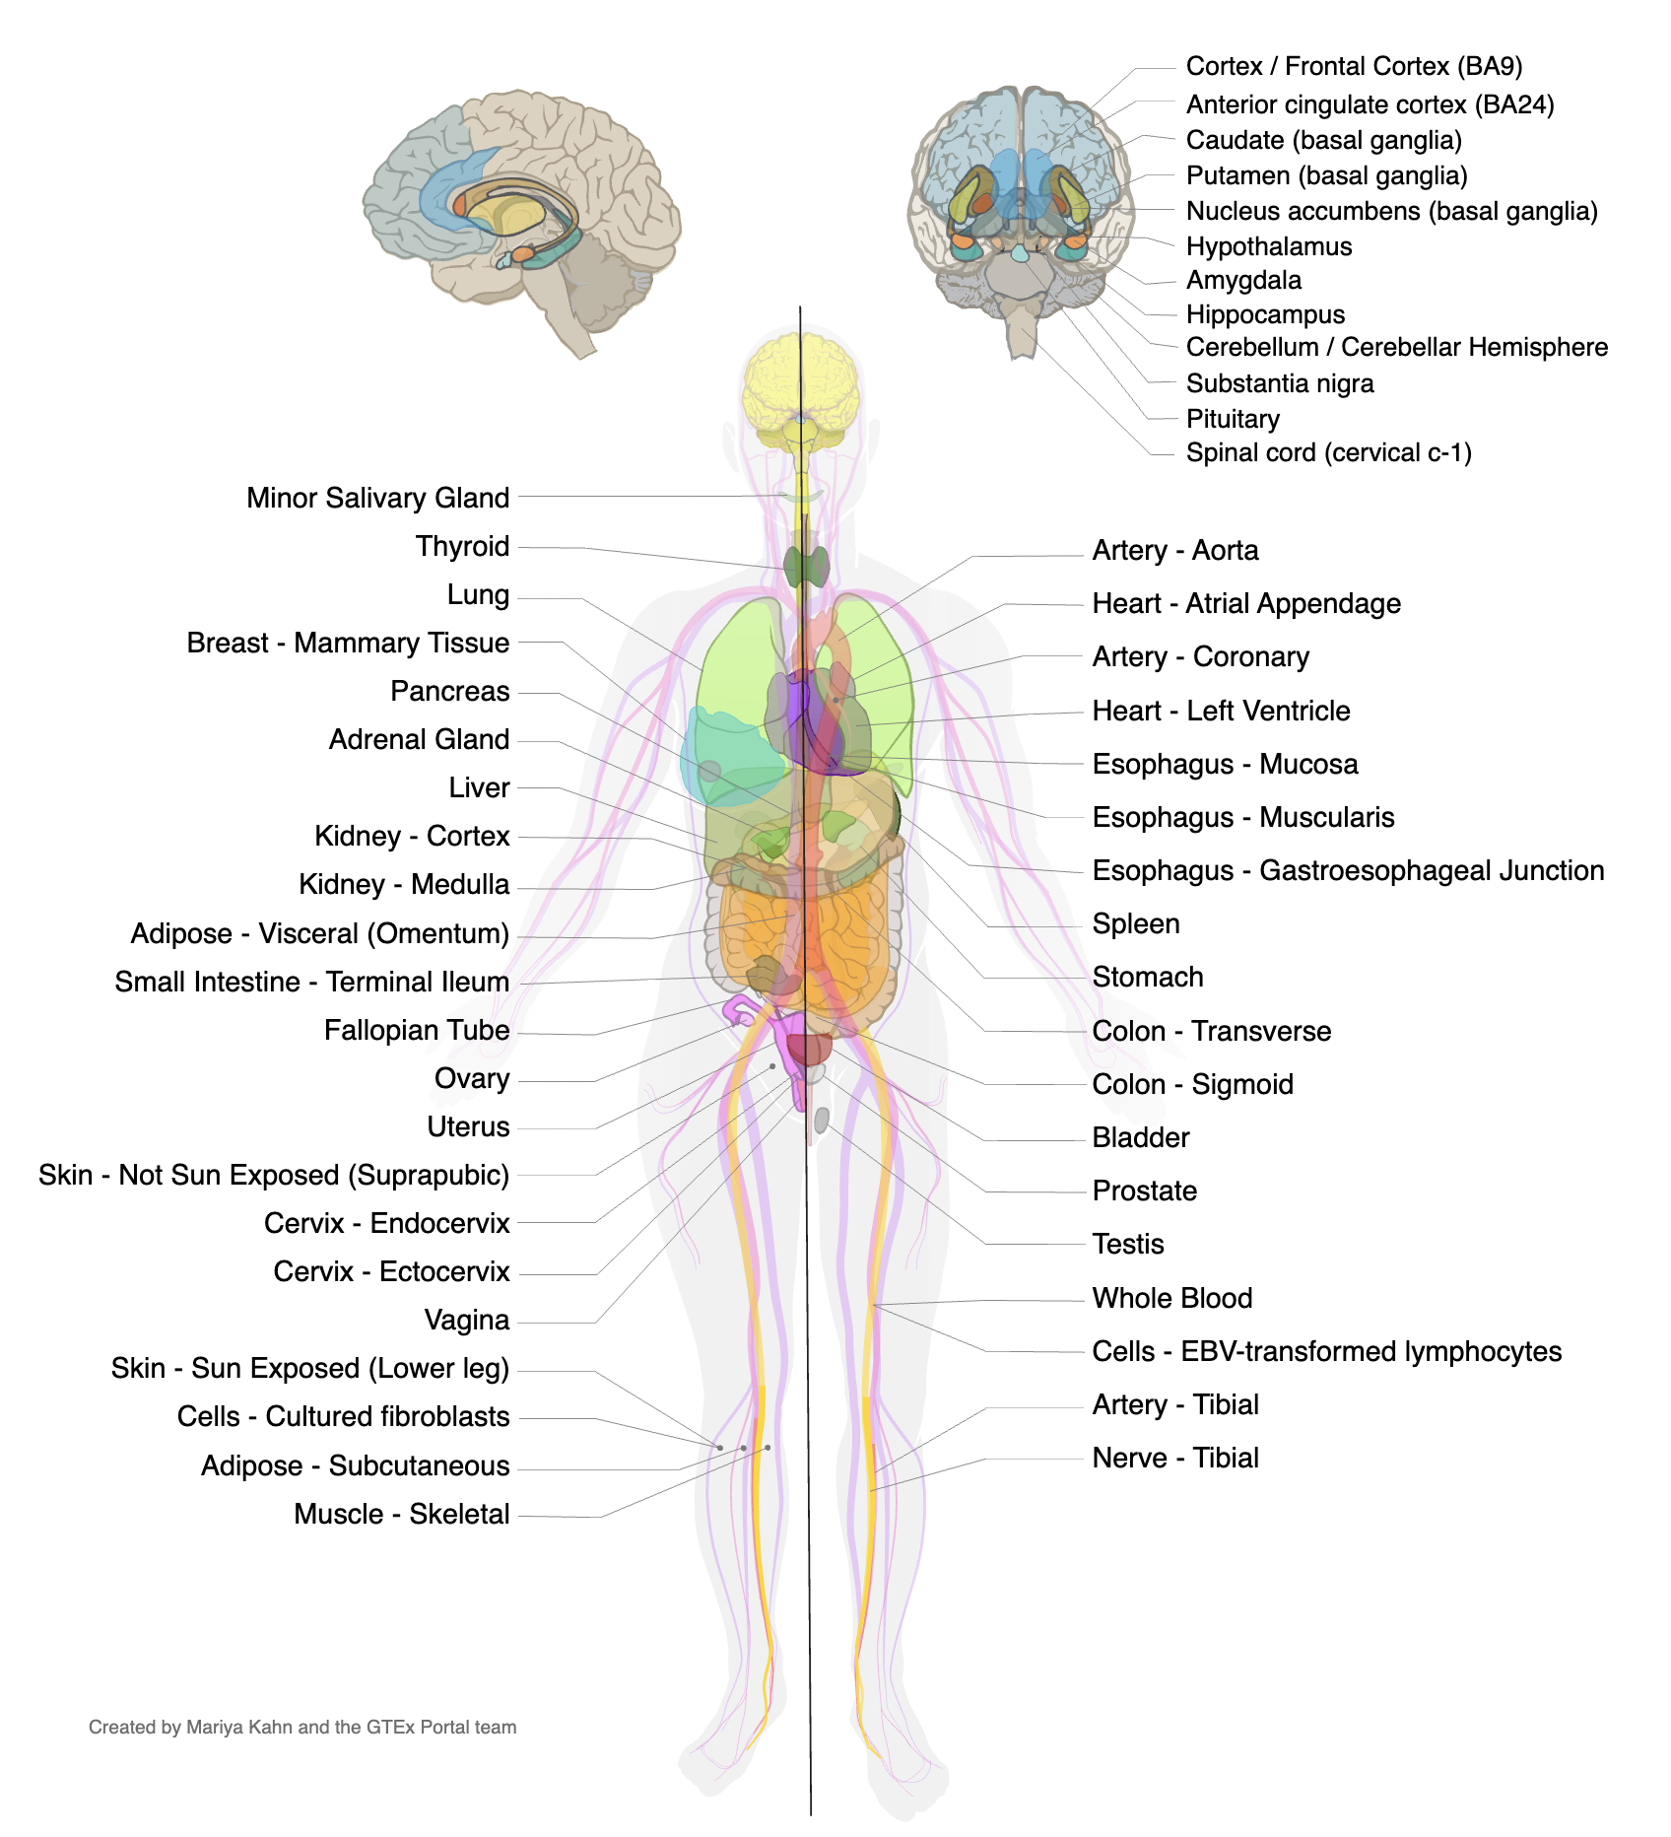
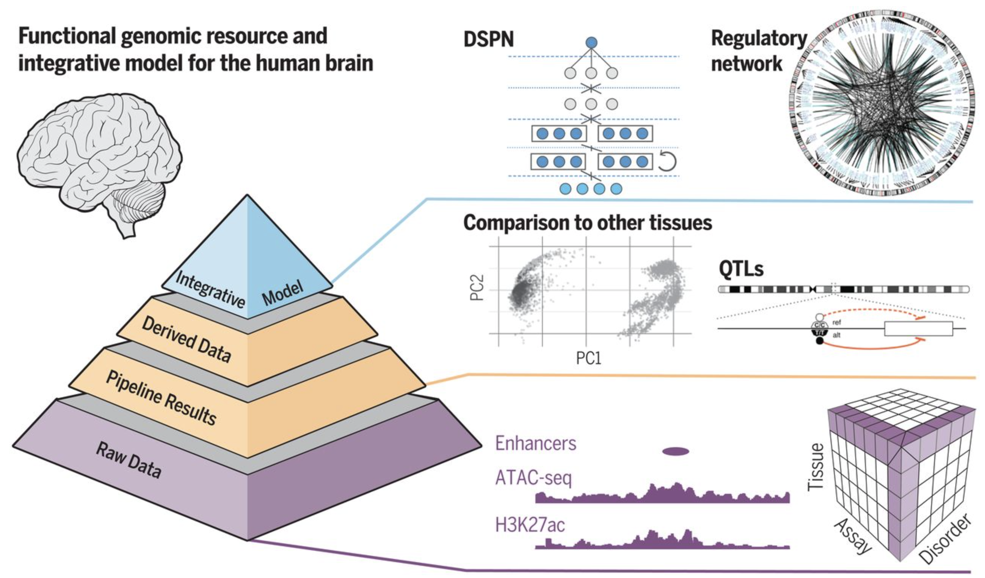
Large-scale efforts to measure gene function

Slide 18
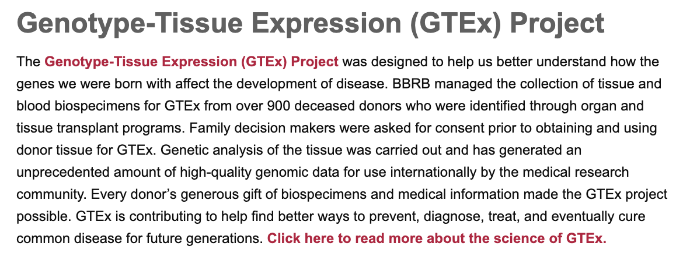
Genotype-Tissue Expression Project
Version 8
https://www.gtexportal.org/

Slide 19

Concepts behind measuring gene expression

Slide 20
Measuring expression eventually….
rs1234
rs2345
rs3456
rs4567
rs5678
Average across by Gene
Visualize by Tissue
At one point of the DNA
Variant – AA – AG – GG

Slide 21
PsychENCODE: Better resource for brain related disorders
Established in 2015 by the National Institute of Mental Health (NIMH), the PsychENCODE Consortium (PEC) is a multi-site investigation of the genomic basis of neuropsychiatric diseases. The aim is to create a resource of mechanistic insights to guide future therapeutic development.
Genomic influences on neural function are remarkably complex, characterized by a highly polygenic risk architecture and often located in the non-coding parts of the genome. A key objective of PEC is to delineate an enhanced framework of regulatory genomic elements associated with neuropsychiatric disorders.

Slide 22
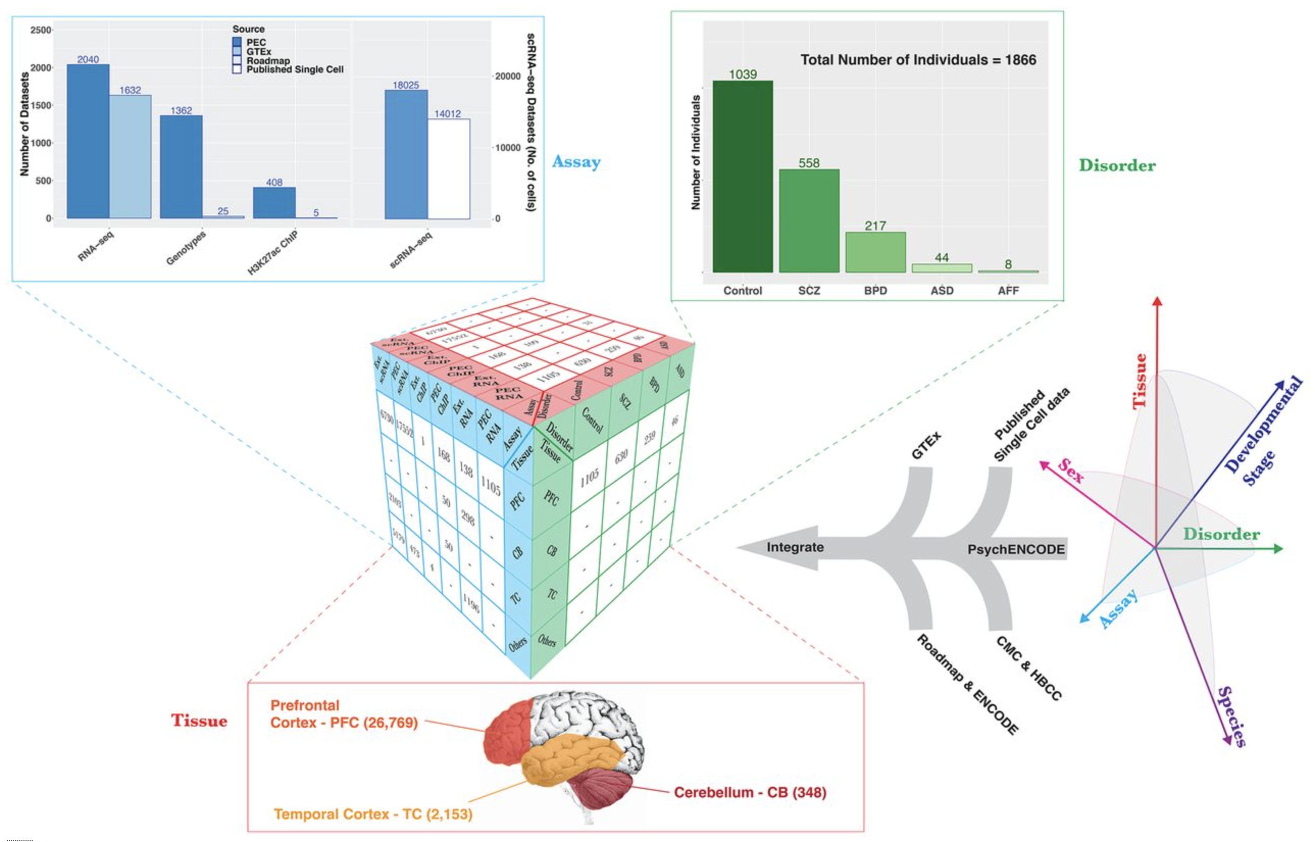
Prefrontal Cortex, Temporal Cortex, Cerebellum…
Sub-regions
dorsolateral prefrontal cortex, anterior cingulate cortex and inferior temporal cortex, hippocampus, amygdala, caudate nucleus, nucleus accumbens and cerebellar cortex
Most essential regions implicated in Brain disorders
Schizophrenia
Bipolar
ASD
Wang et al., 2018 - Comprehensive functional genomic resource and integrative model for the human brain

Slide 23
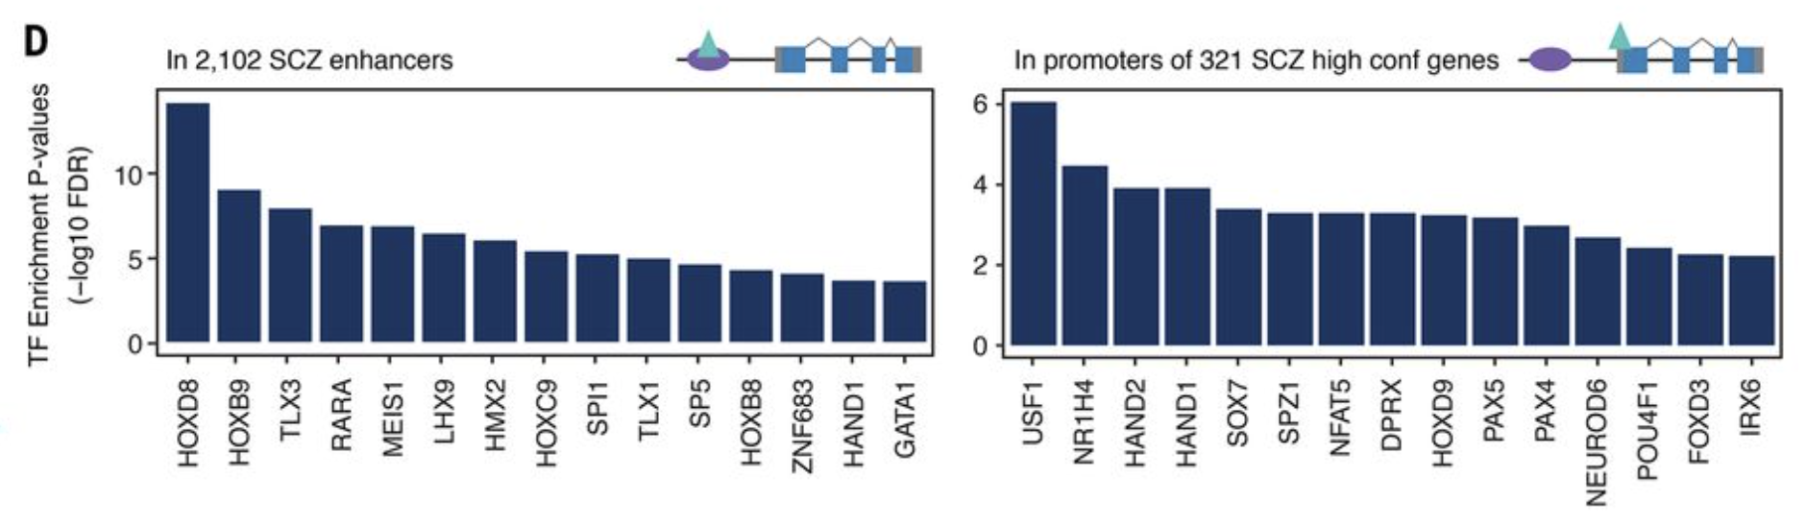
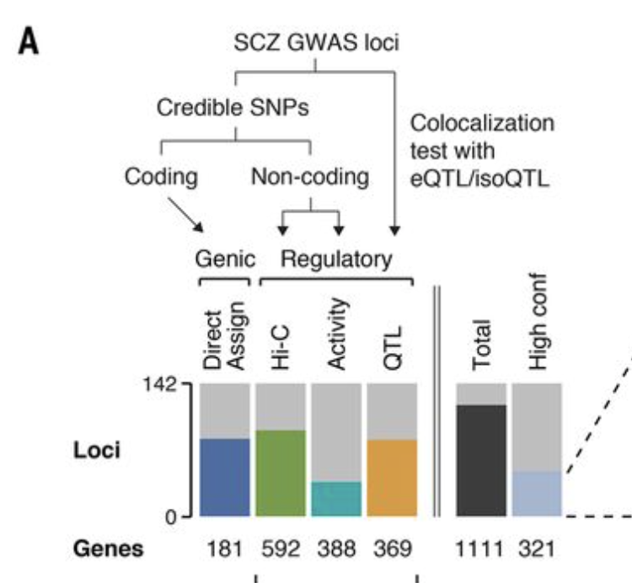
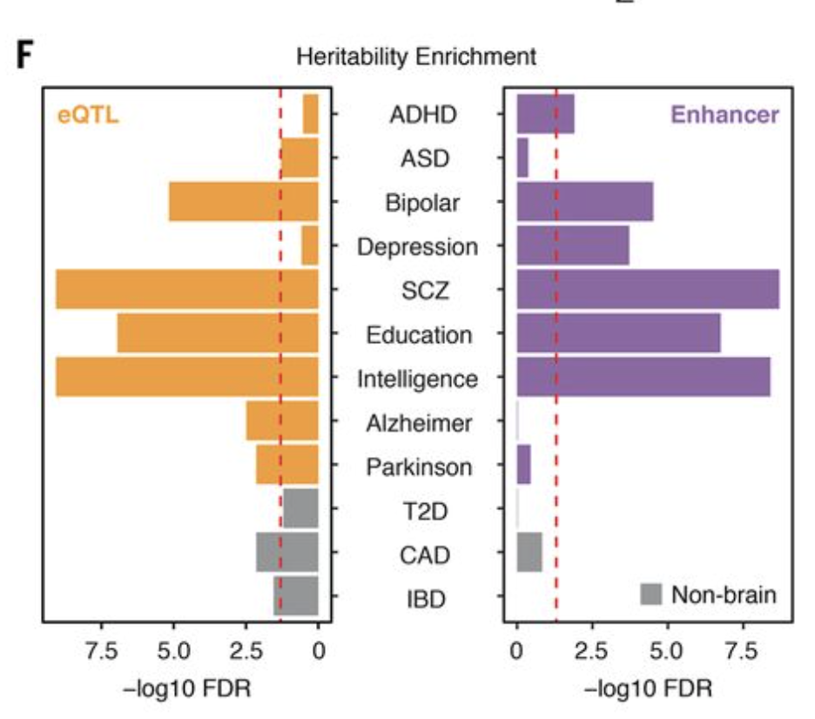
PsychENCODE – integrative analysis
Wang et al., 2018 - Comprehensive functional genomic resource and integrative model for the human brain

Slide 24
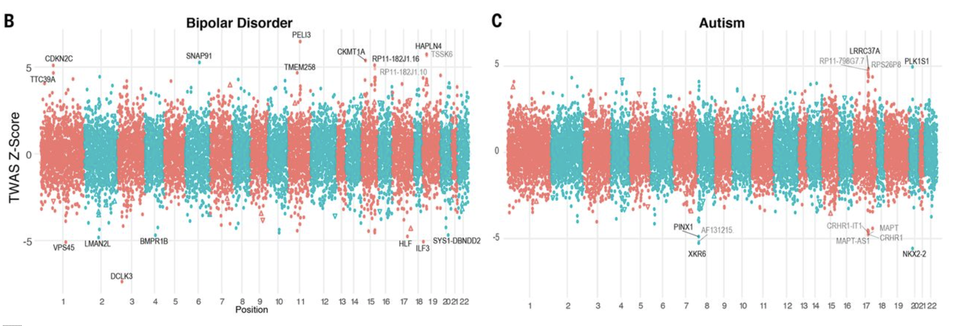
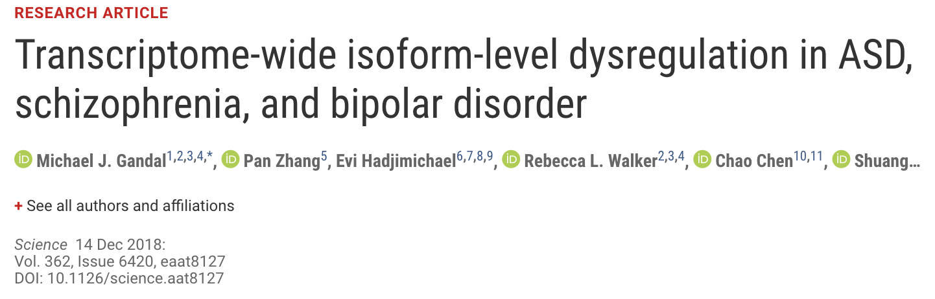
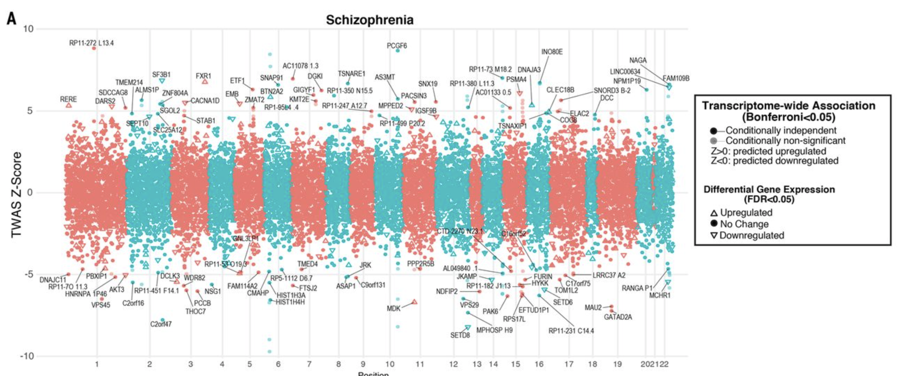
PsychENCODE : Cross Disorder Analysis

Slide 25
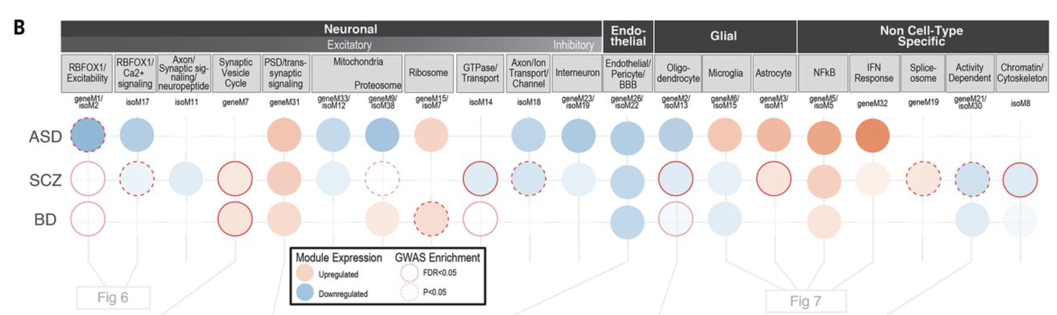
Genes to pathways!

Slide 26
Opportunities and Challenges of TWAS
Getting into the nuts and bolts of it….

Slide 27
A more in-depth look at TWAS methodology
Colocalization
S-Predixcan
SMR/HEIDI
Resources
Use case scenario

Slide 28
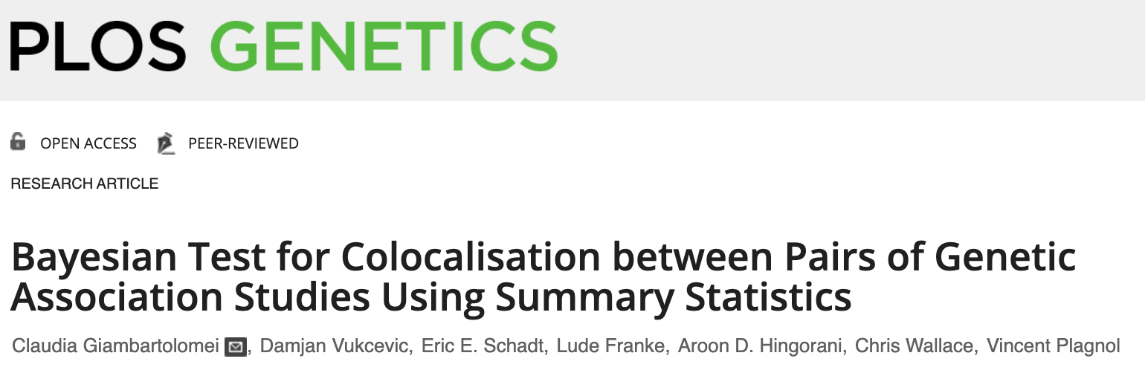
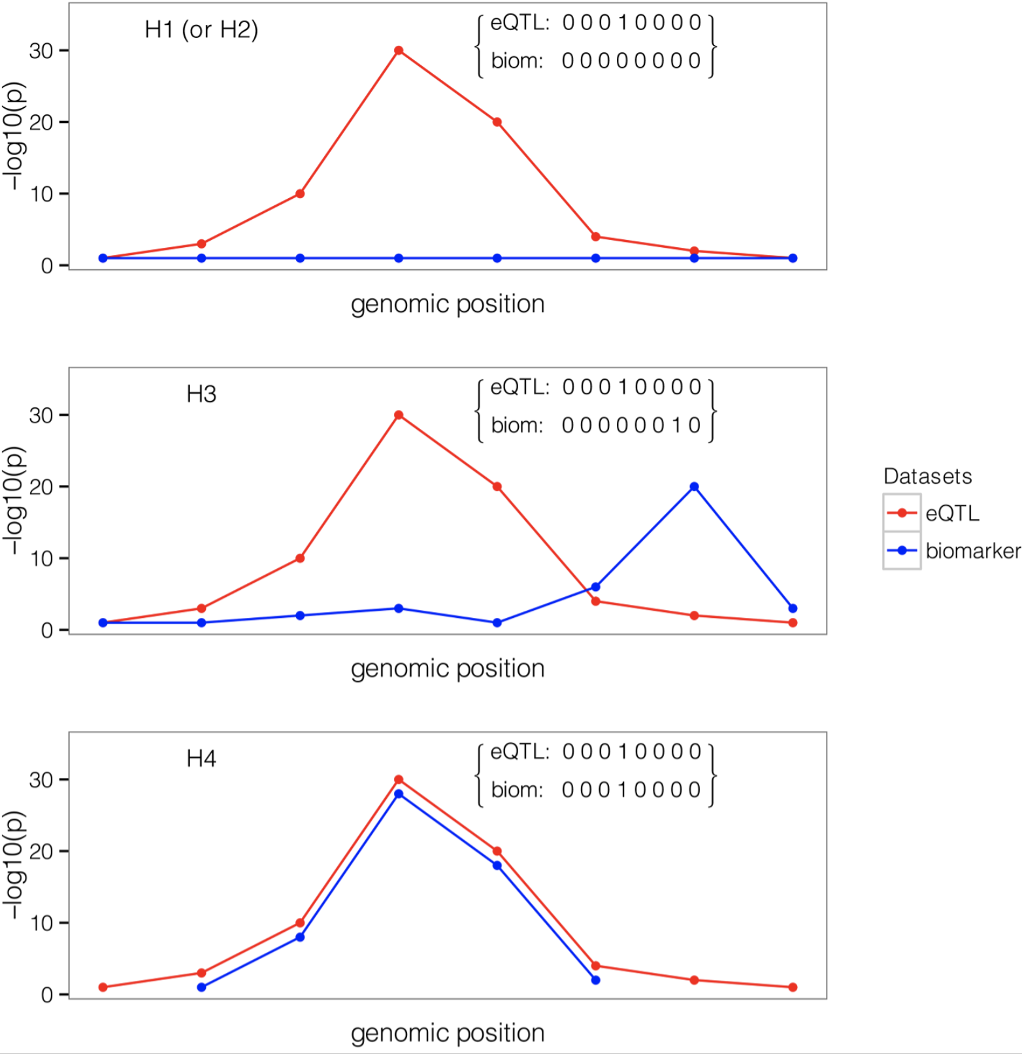
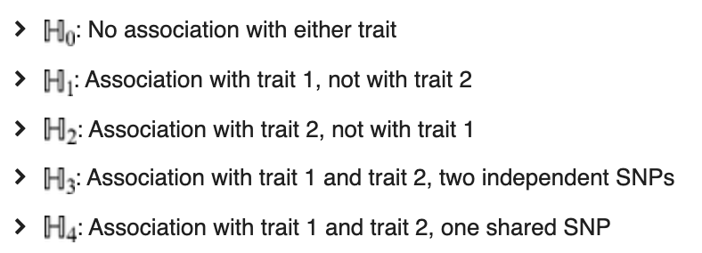
Concepts & Key hypotheses behind Colocalization
Bayesian Test for Colocalisation between Pairs of Genetic Association Studies Using Summary Statistics
Claudia Giambartolomei et al

Slide 29
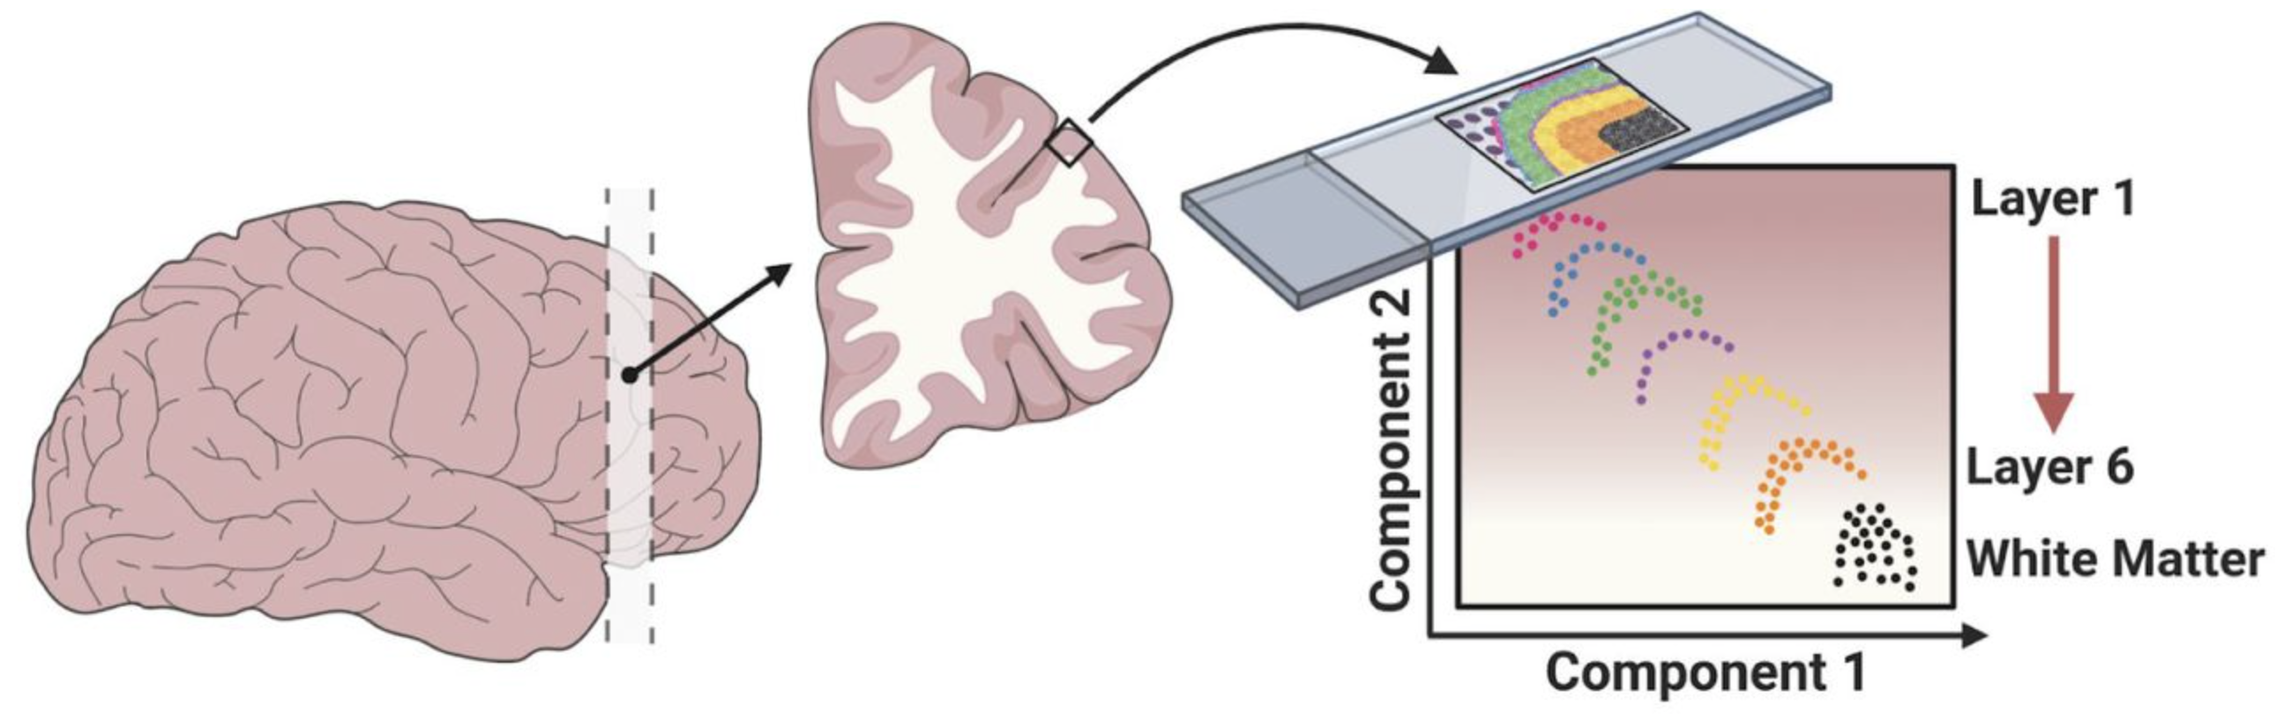
PrediXcan : “PrediXcan, by design, exploits genetic control of phenotype through the mechanism of gene regulation as a way to identify trait-associated genes”
Trait
eQTL
eQTL
SNP
SNP
SNP
Trait
Trait
Trait
GWAS
Transcriptome-scale spatial gene expression in the human dorsolateral prefrontal cortex
Maynard et al., BioRxiv
expression
AA.----------AG.-----------GG
TWAS
Genotype at a SNP
AA = +++
AG = ++
GG = +
AA.----------AG.-----------GG
Genotype at a SNP
SNP rs1234 is related to traitA because it is likely that individuals with the G allele don’t express X protein at gene ABCD.
AA.----------AG.-----------GG
Genotype at a SNP – which sits on GENE ABCD’s Transcription site
Never that simple….

Slide 30
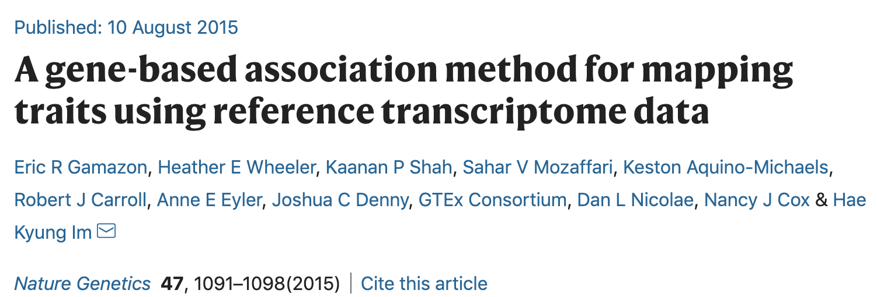
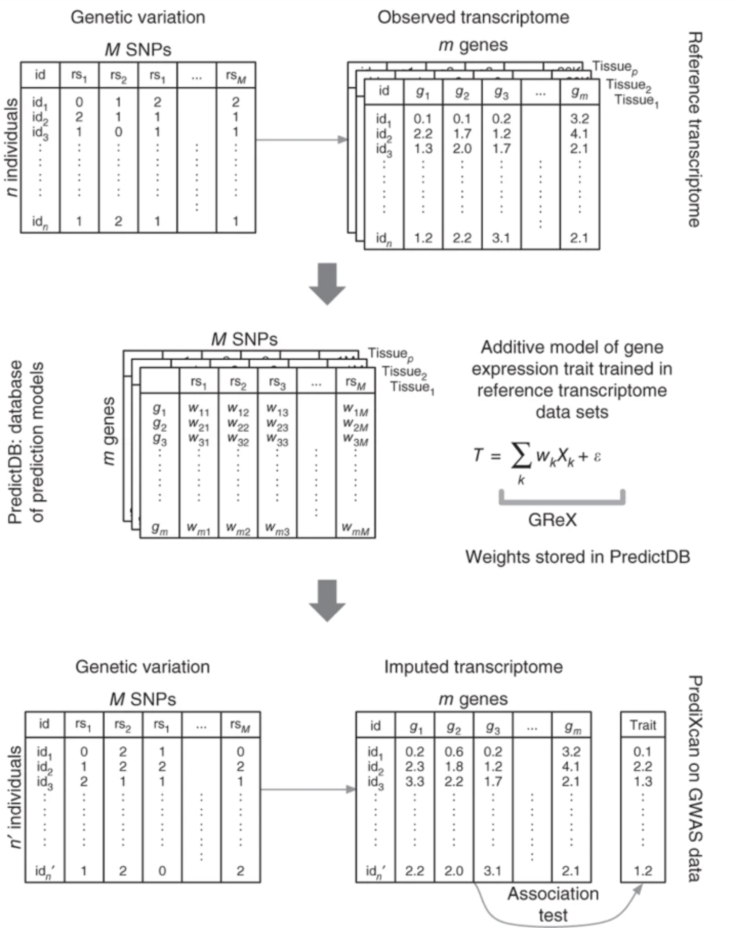
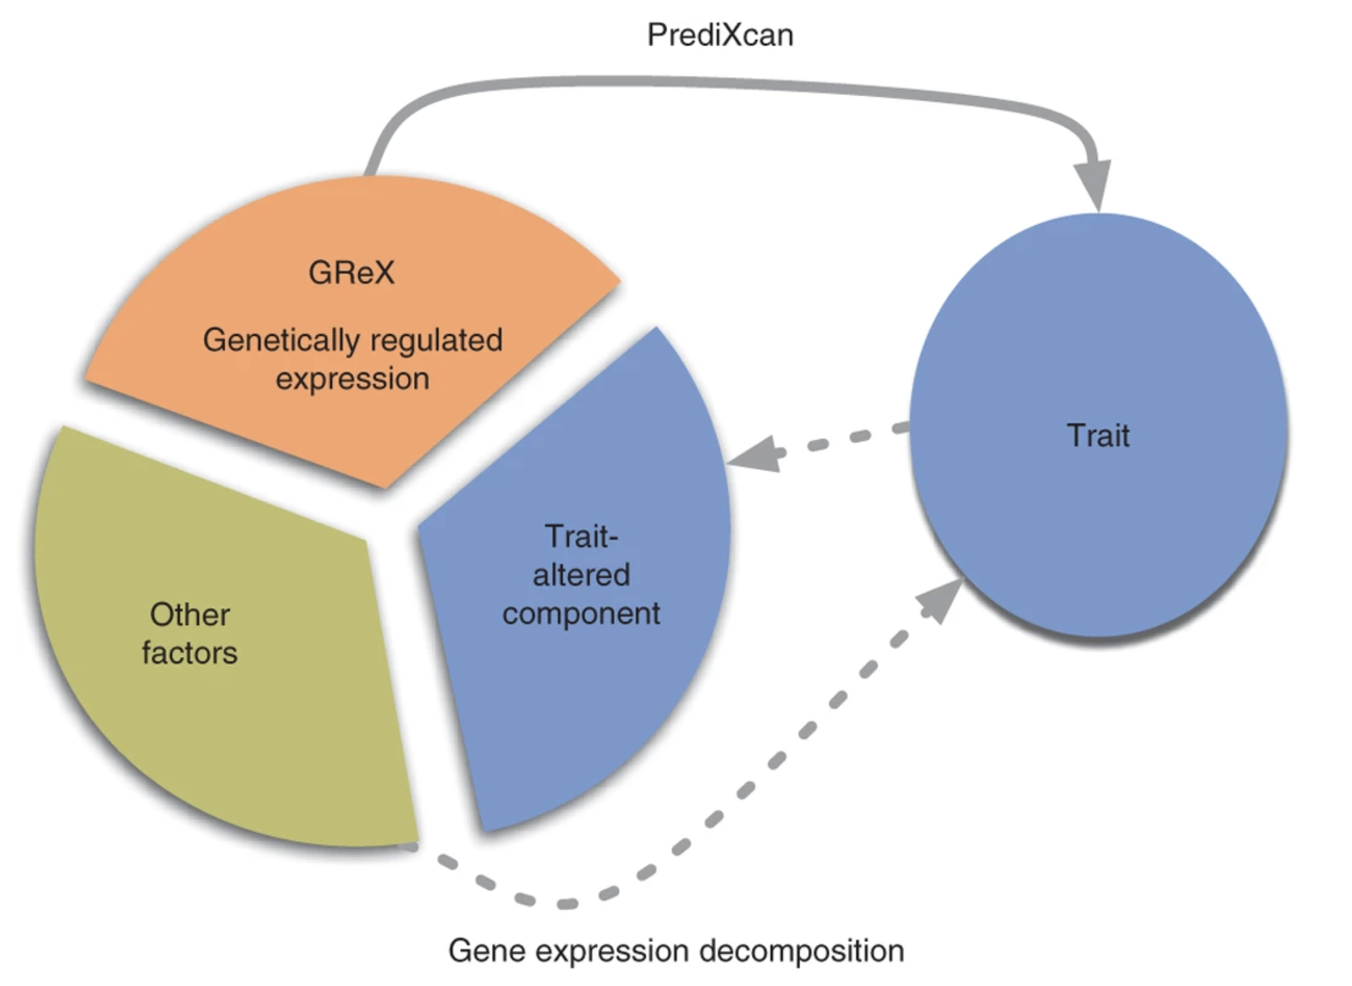
PredictDB: Estimating weights from eQTL data
Data from eQTL databases e.g. GTEx
SNP
eQTL
This is a regression analysis –
T = gene expression
X = SNP
W = beta
If we know the genotype, and the beta, we could “guess” the expression for a gene for a given individual
Allows a “new” predictor to be generated for association analysis
Original genotype data

Slide 31
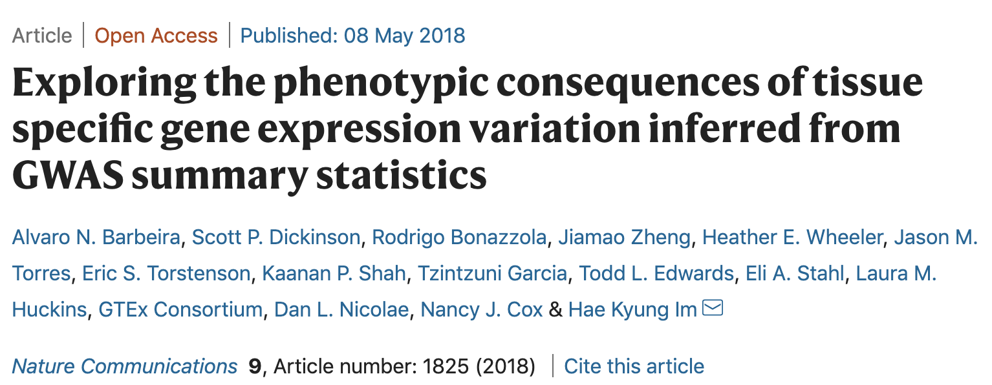
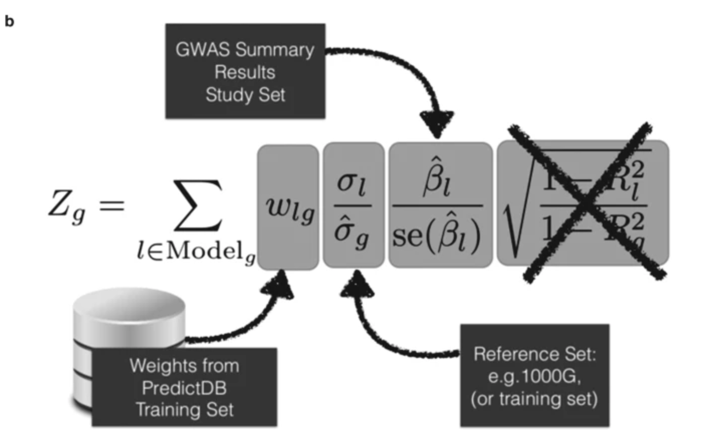
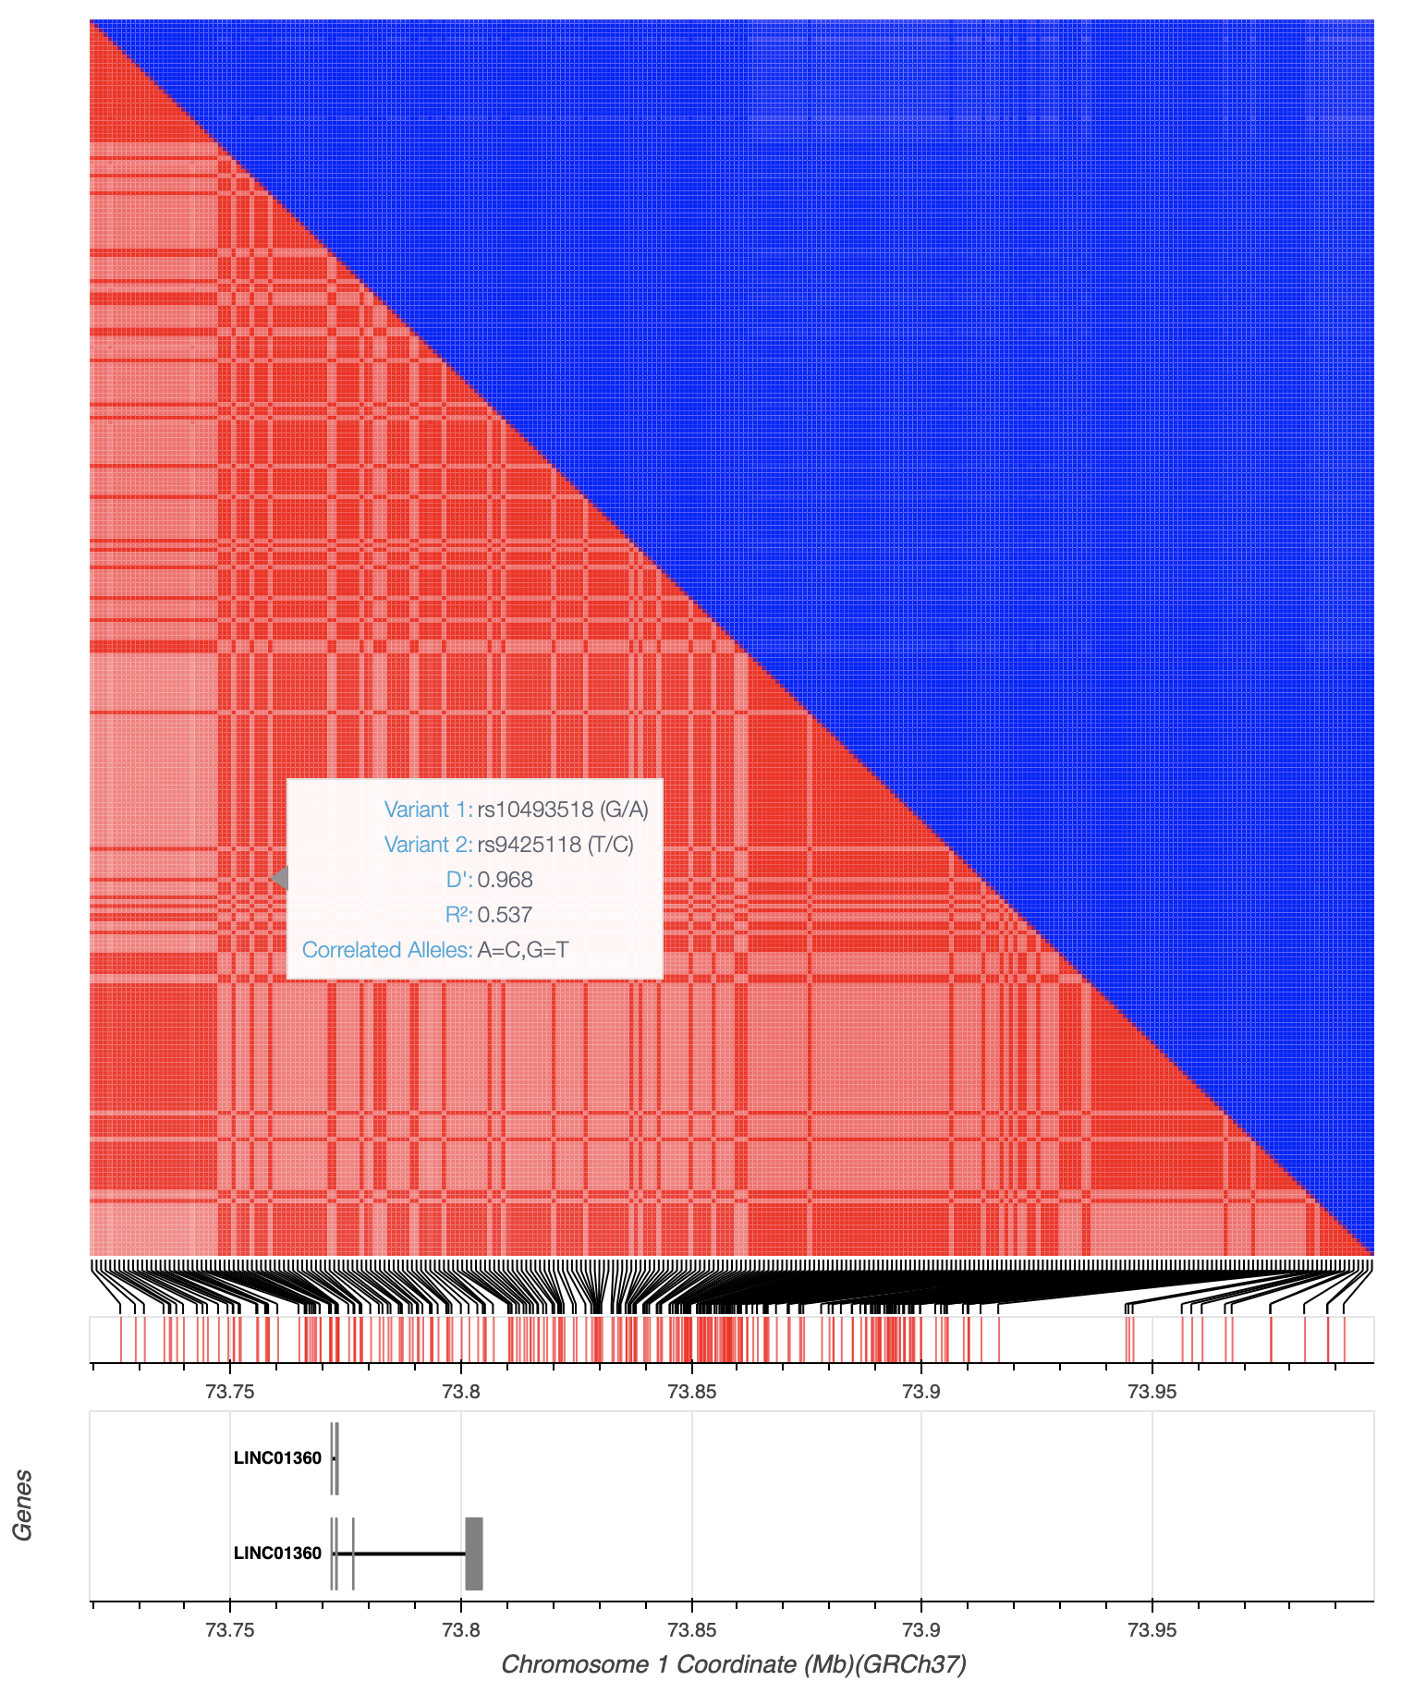
What if there is no access to the genotypes?
Answer: S-PrediXcan
GWAS sumstats
Reference Panel
PredictDB weights

Slide 32

TWAS sounds like a great tool for understanding biology…
TWAS is especially prone to spurious prioritization with expression data from non-trait-related tissues or cell types, owing to substantial cross-cell-type variation in expression levels and eQTL strengths. Nonetheless, TWAS prioritizes candidate causal genes more accurately than simple baselines. - Weinberg et al, 2019

Slide 33
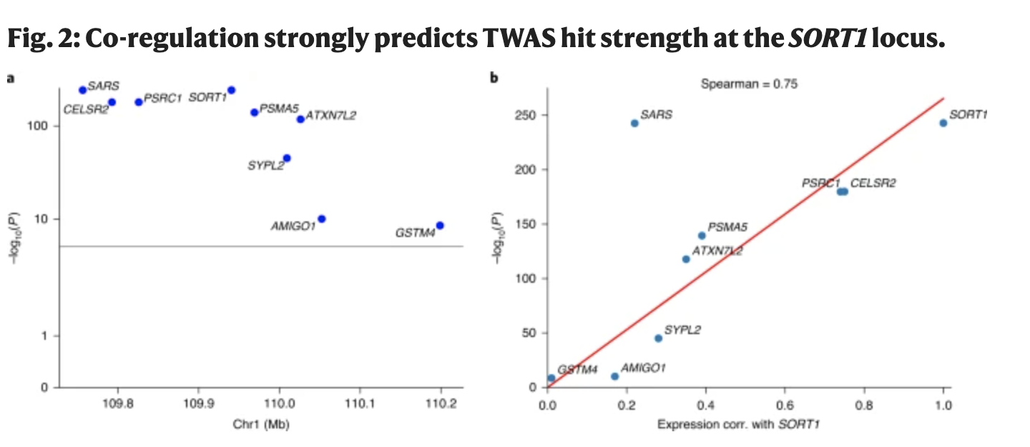
What’s the problem here?
Just like SNPs can be highly correlated through LD
TWAS genes can be highly correlated through co-regulation
Therefore – TWAS results are not independent!
From Weinberg et al., 2019 – Opportunities and challenges for TWAS
??
??
Expression predicted from genotypes Not out of the woods from LD contamination
Gamazon et al., 2015 - A gene-based association method for mapping traits using reference transcriptome data
LD…

Slide 34
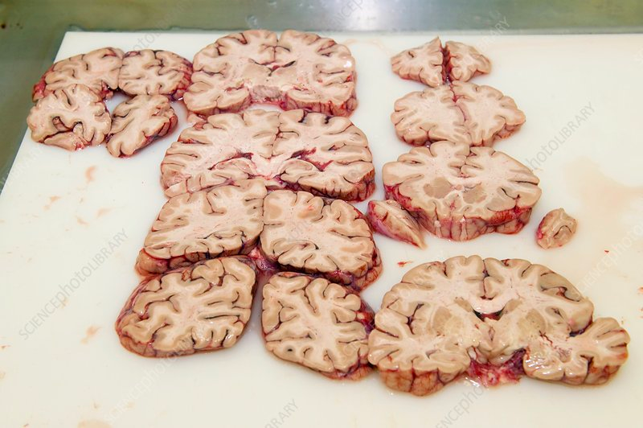
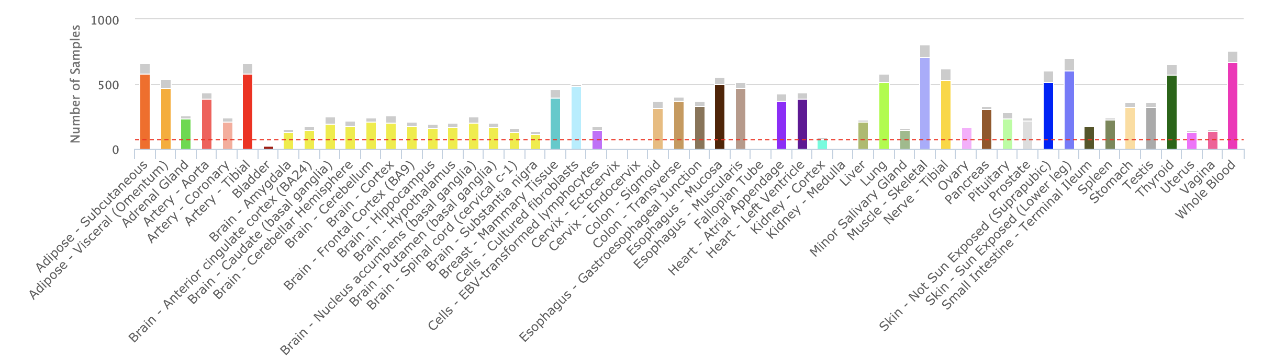
More problems….And dilemma…
Cognitive Function
Not many N for brain tissue
Use all tissues!! Larger N
Credit : SCIENCE PHOTO LIBRARY
GENE
Cognitive Function
skin

Slide 35
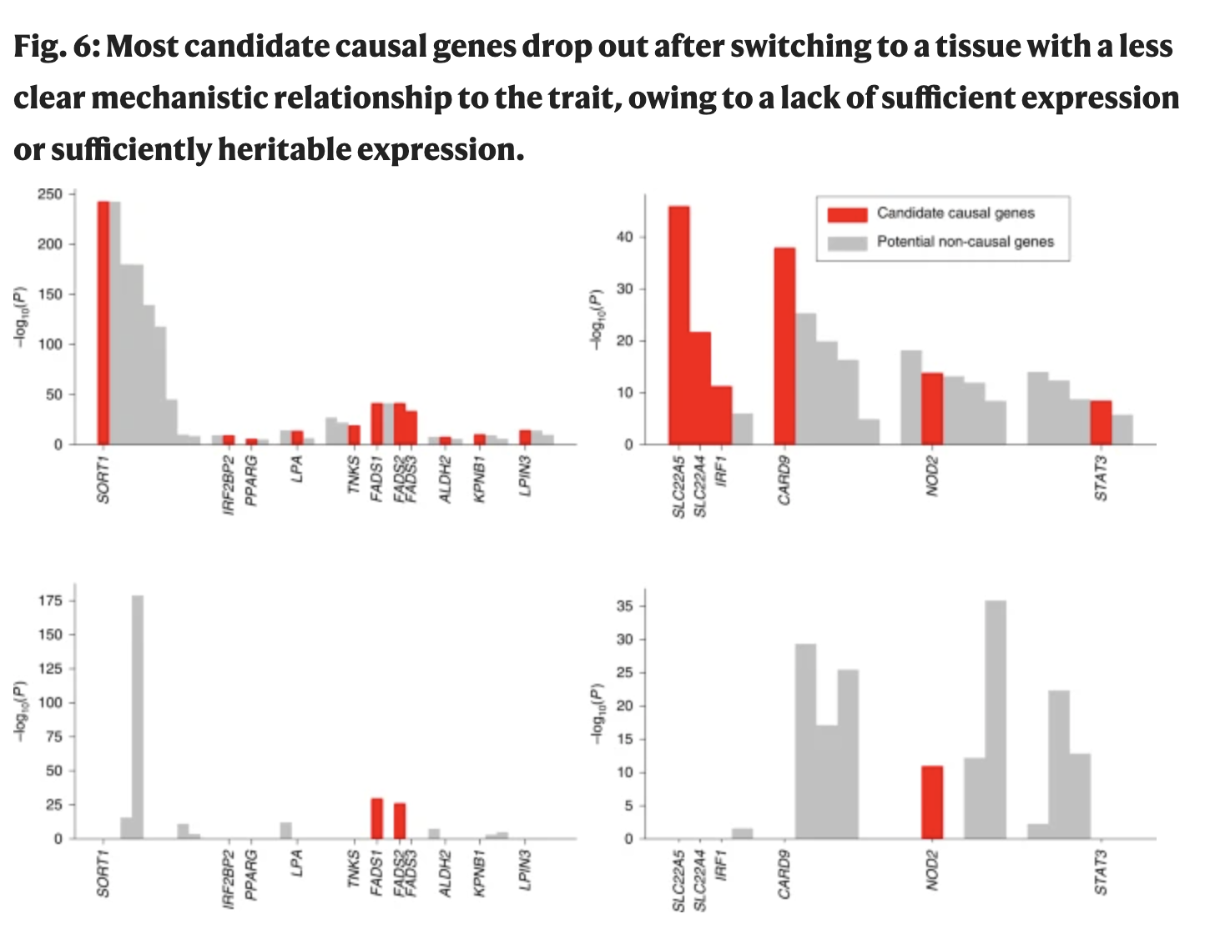
Most causal genes with tissue-trait mismatch drops out ……. “Most……”
Potential for false positives
From Weinberg et al., 2019 – Opportunities and challenges for TWAS

Slide 36
TWAS sounds interesting…Where do I start?
Getting most TWAS stuff into a single repo

Slide 37
TWAS Framework
GWAS Summary Statistics
S-PrediXcan format
GCTA COJO format
FUMA format
FOCUS (LDSC+) format
ElasticNet eQTL weights
BESD format eQTL weights
FUMA GWAS
ElasticNet eQTL weights
MASHR eQTL weights
eQTL mapping
Tissue Specific
S-PrediXcan
SMR
Colocalization
FOCUS
Combined Tissue
S-MultiXcan
HEIDI

Slide 38
Set up of TWAS suite of software

